Slide 1
Utah’s Government Structure
Objective: I can explain the structure and responsibilities of local government.

Slide 2
Territorial vs. State Government
Territorial
Mormon leaders led the government
National Government appointed Governor and Judges
State Government
3 Branches, chosen by the people
County and City Government
Which one looks more like the U.S. National Government?

Slide 3
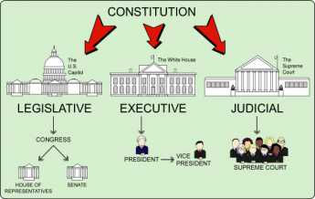
STATE GOVERNMENT
NATIONAL GOVERNMENT

Slide 4
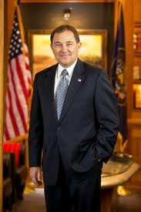
Executive Branch
Administers the Laws
Governor: Gary Herbert
Directs State Government
Commander in Chief of UT National Guard
Can present bills to the legislature
Can call special sessions of the legislature
Signs (approves) or vetoes bills
Can forgive people convicted of crimes

Slide 5
Executive Branch
Lieutenant Governor: Spencer J. Cox
Keeps record of legislature, acts as governor when governor is out of the state
State Treasurer: Richard K. Ellis
Directs spending of state money
State Auditor: John Dougall
Look after state’s financial records
Attorney General: John Swallow
Does Legal jobs for the Governor
State Boards, Departments, and Commissions
Mining Safety, agriculture, water, land use and preservation, education, etc.

Slide 6
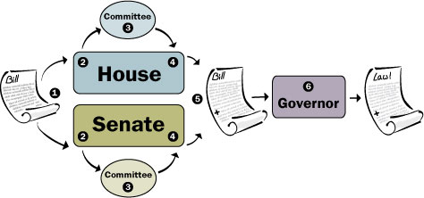
Legislative Branch
Makes the Laws
Two houses with no term limit!
Senate: 29
House of Representatives: 75

Slide 7
Judicial Branch
Interprets and applies the laws
Utah has Federal, State, County, and City Courts
Utah’s Supreme Court
Has the final interpretation of Utah’s Constitution

Slide 8
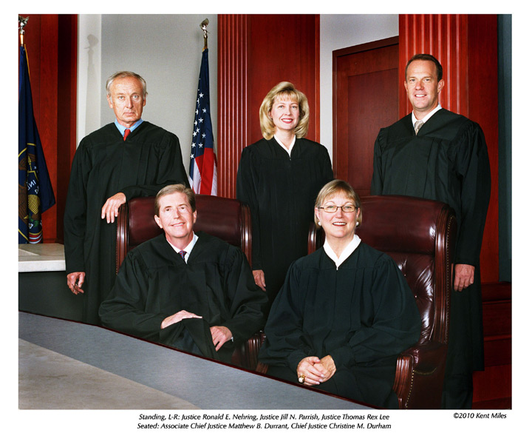
Utah’s Supreme Court

Slide 9
Local Government
Most Citizens interact with government most here!
County Government
Levies taxes, holds elections, carry out laws
Buy property, build buildings
Public health, SCHOOLS, libraries
City Government
Streets, parks, water, sewage, garbage disposal
Snow removal, fire and police protection, cemeteries

Slide 10
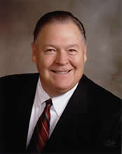
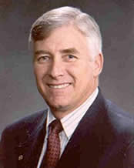
County Government
Led by a Board of County Commissioners
Other county officers perform executive and legislative jobs
Counties have their own courts
Utah County Commissioners:
Gary J. Anderson
Doug Witney
Larry Ellertson

Slide 11
Types of City Government
Mayor-Commission
Mayor-Council
LIKE ALPINE!
President-Town Board
The type of government
depends on the size
of the city!

Slide 12
Rights v. Responsibilities
Right: A freedom that is protected
Responsibility: A duty or something you should do

