Slide 1
The Pony Express

Slide 2
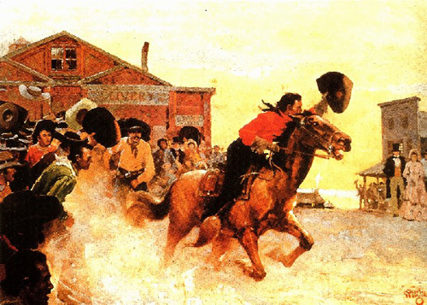

Slide 3
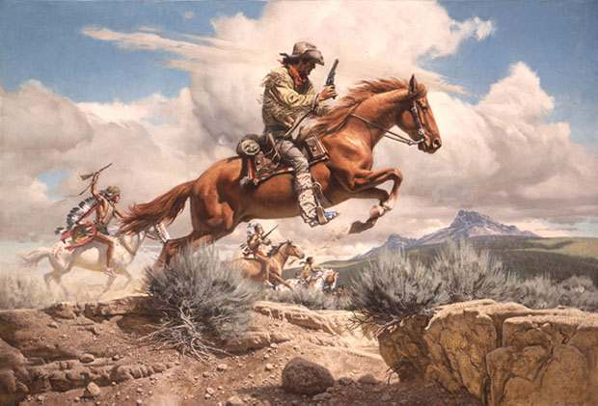

Slide 4
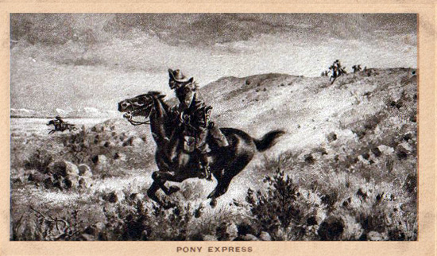

Slide 5
Before the pony express
“No mail has been received from the East since last November. As yet we have no certain information who was elected President of the United States.”
Brigham Young, April 1853

Slide 6
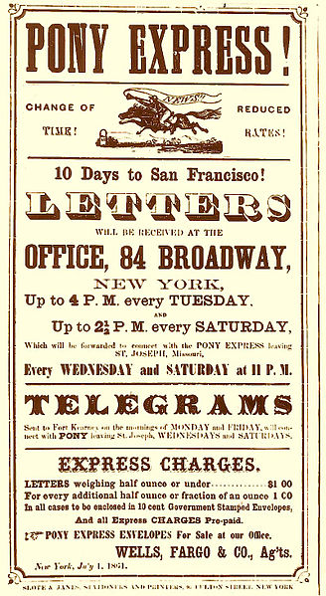
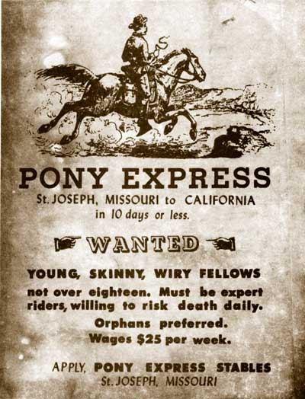

Slide 7
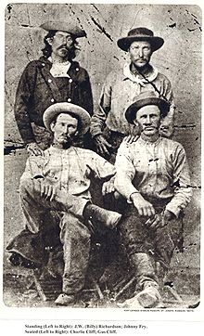
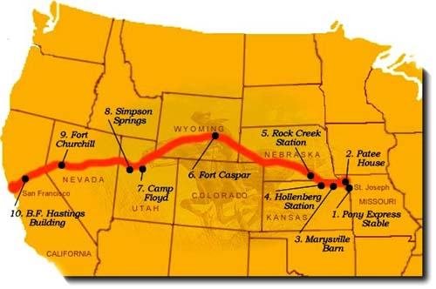
St. Joseph, MISSOURI TO SAN FRANCISCO

Slide 8
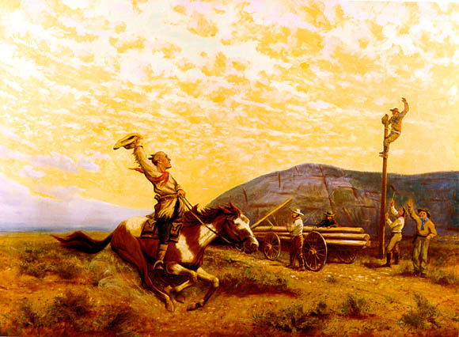

Slide 9
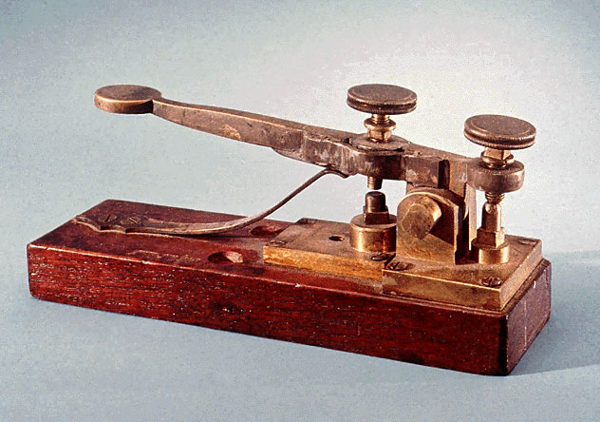
End of pony express
Telegraph- faster than the ponies
Sent coded messages of dots & dashes over wire lines
April 1860-October
1861(19 months)

