Slide 1
Territorial Utah and The Utah War
Chapter 9

Slide 2
Utah becomes a territory
Voted to allow slavery
Run by federal government
President Fillmore appoints Brigham Young governor
3 judges appointed from the East
This makes people upset

Slide 3
The Utah War
The 3 Judges return to D.C. and tell the president…
Mormons are killing non-Mormons
Mormons are destroying legal records
Mormons treat non-Mormons unfairly in court
President Buchanan appointed a new governor and sent Johnston’s army to escort him to the Utah Territory
Brigham Young assumes it is an attack, so he calls out the militia

Slide 4
The Utah War
Mormon Militia prepare for Johnston’s army by…
Destroying supply wagons, animal feed, and driving off animals
Also burned Fort Bridger and Fort Supply
Army forced to stop in Wyoming due to snow and lack of supplies
Mormons abandoned Salt Lake City and other northern communities
Prepared their homes, food, and fields to be torched
Buried foundations of Salt Lake Temple

Slide 5
Mountain Meadows Massacre
1857: Mormons are preparing for Johnston’s army
120 Arkansas and Missouri immigrants (the Fancher party) cross southern Utah on their way to California
Mormons will not trade with the Fancher party
A Mormon leader had just been killed in Arkansas, and these immigrants started bragging about the murder
A rumor that the immigrants had poisoned a well, killing Paiutes and their animals
Paiutes attacked but were driven back

Slide 6
Mountain Meadows
Isaac Haight sent a rider to SLC to ask Young for advice
Haight and John D. Lee decided to ally with the Paiutes and attack the immigrants
Paiutes encircled the immigrants, and then Lee approached with a white flag of truce
Mormons agreed to give the immigrants safe passage if they put their weapons away
Sent women and children ahead of the men

Slide 7
Mountain Meadows
Had one soldier next to each male immigrant
“Halt, each man do your duty.”
Turned and shot the immigrant, or stepped back and allowed the Paiutes to do it
Killed all of the men, then went and killed all of the women, and any children old enough to report
Only 18 small children were left alive

Slide 8
Camp Floyd
Army entered in spring of 1858 to find SLC deserted.
Set up a military base in the Oquirrh Mountains; Camp Floyd
Good things that Camp Floyd or the army brought to Utah
Strengthened Utah’s economy, provided jobs, soldiers had to buy supplies from Utahans
Bad things that Camp Floyd or the army brought to Utah
Brought the “Wild West” to Utah… gamblers, saloons, prostitution, cattle rustlers, etc.
Had to have a gun or didn’t feel safe
Johnston’s army called back when Civil War started in 1860
War ended without a shot fired
Colonel Patrick Connor replaces Johnston’s army

Slide 9
The New Governor
Alfred Cumming, the new governor, tried to be fair to all people
Won more friends than enemies
Abraham Lincoln sent Colonel Patrick Connor with a group of men to “protect overland mail route”
Probably to keep an eye on the Mormons
Cold War

Slide 10
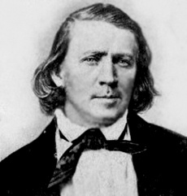
Polygamy
Did you know that Brigham Young had 56 wives… many were widows that were older than him that he cared for. He had a total of 57 children with 16 of his wives.

Slide 11
Issues with Polygamy
People in the East believed that if women in Utah could vote, they would end polygamy
When they didn’t, the federal government took away the right to vote as punishment
Republican Party’s platform was to eliminate the “twins of barbarism – slavery and polygamy”
Passed laws making polygamy illegal – could be arrested for 5 years and fined $500 (equal to $11,000 today).

Slide 12
Reynolds v. United States
Mormons believed polygamy was protected under the 1st amendment, and that the Supreme Court would agree
Took the case to the Supreme Court, but the Court decided that beliefs not practices were protected
Polygamy declared illegal
“Can a man excuse his practices…because of his beliefs? To permit this would be to…permit every citizen to become a law unto himself.” (Chief Justice Waite)

Slide 13
Consequences
Cohab hunting: informers were paid $20 for each polygamist they found ($450 of today’s money)
Became a favorite pastime and source of income for Utahans
Many Mormon men chose to go to prison rather than give up polygamy
Many polygamists went into hiding. Others went to Mexico or Canada. Others were called on missions to foreign countries.
John Taylor became the leader in 1877, and died while in hiding in 1887

Slide 14
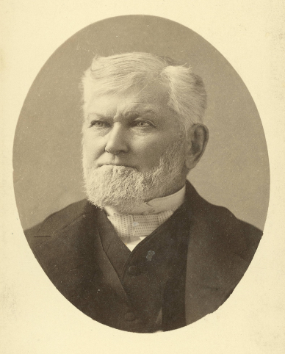
The Manifesto
Impossible for Mormons to live polygamy
President Wilford Woodruff (4th leader) issued the Manifesto in 1890, ending polygamy
“Inasmuch as laws have been enacted by Congress forbidding plural marriages, which laws have been pronounced constitutional by the court of last resort, I hereby declare my intention to submit to those laws, and to use my influence with the members of the Church over which I preside to have them do likewise…I publicly declare that my advice to the Latter-day Saints is to refrain from contracting any marriages forbidden by the law of the land.” (Woodruff)

