Slide 1
Settlement of Utah
How can you predict the types of town Mormons settled?

Slide 2
Pioneers Arrive
Pioneers entered the valley on July 24, 1847
Brigham Young: This is the place!
They celebrated pioneer day right away
Most pioneers were farmers
Gold Rush

Slide 3
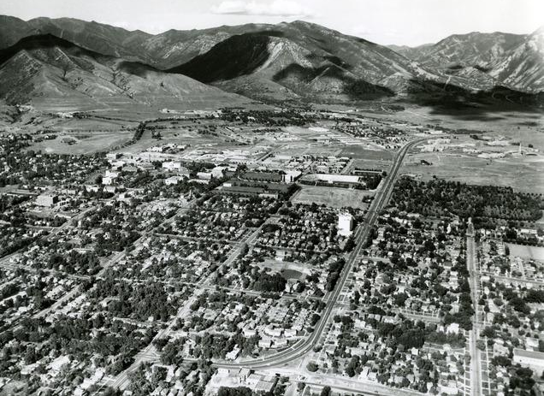
Features of Pioneer Settlements
Streets laid out in grid pattern

Slide 4
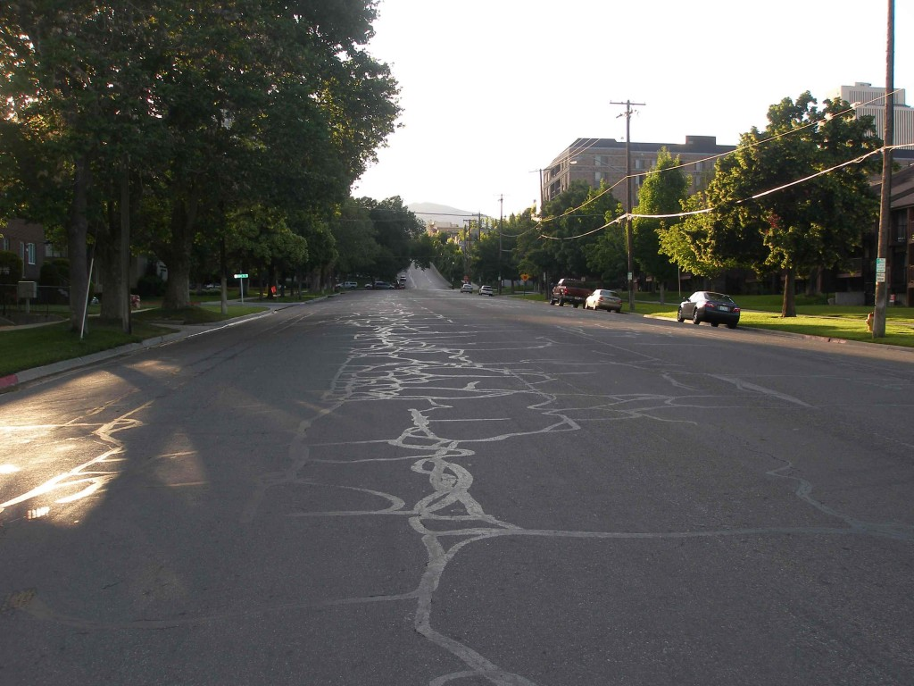
Features of Pioneer Settlements
Wide streets with irrigation ditches along side

Slide 5
Features of Pioneer Settlements
Large city blocks: for homes and gardens
Public buildings and parks (called public squares) in the center of the town
Farmlands lay beyond the public square
Trees surrounded farms to break the wind

Slide 6
Which one was settled by Mormons?
http://www.visitsaltlake.com/includes/content/docs/media/DowntownMAP-WEB0713.pdf
http://www.visitparkcity.com/includes/media/docs/Park-City-Map-2012-Summer-Map.pdf

Slide 7
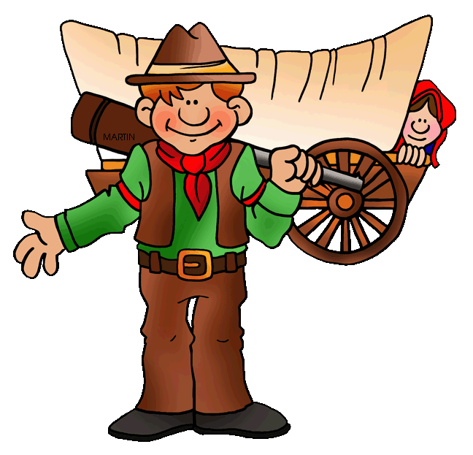
Many Settlement Problems
Unfamiliar Environment. Dry, but fertile land.
Cold, snowy winters, but hot summers
Isolated with no fast communication
Native Americans saw them as intruders
Every year thousand new immigrants came with no money, jobs, or homes. Many didn’t speak English.
Grasshoppers, crickets, and locusts ate their crops.
Severe hot and cold weather made it hard to grow crops, and there were not enough crops to feed everyone.
When non-Mormons came there were conflicts

Slide 8
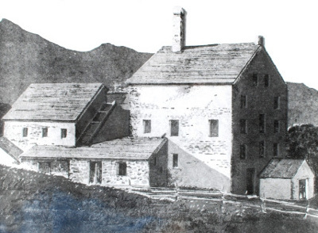
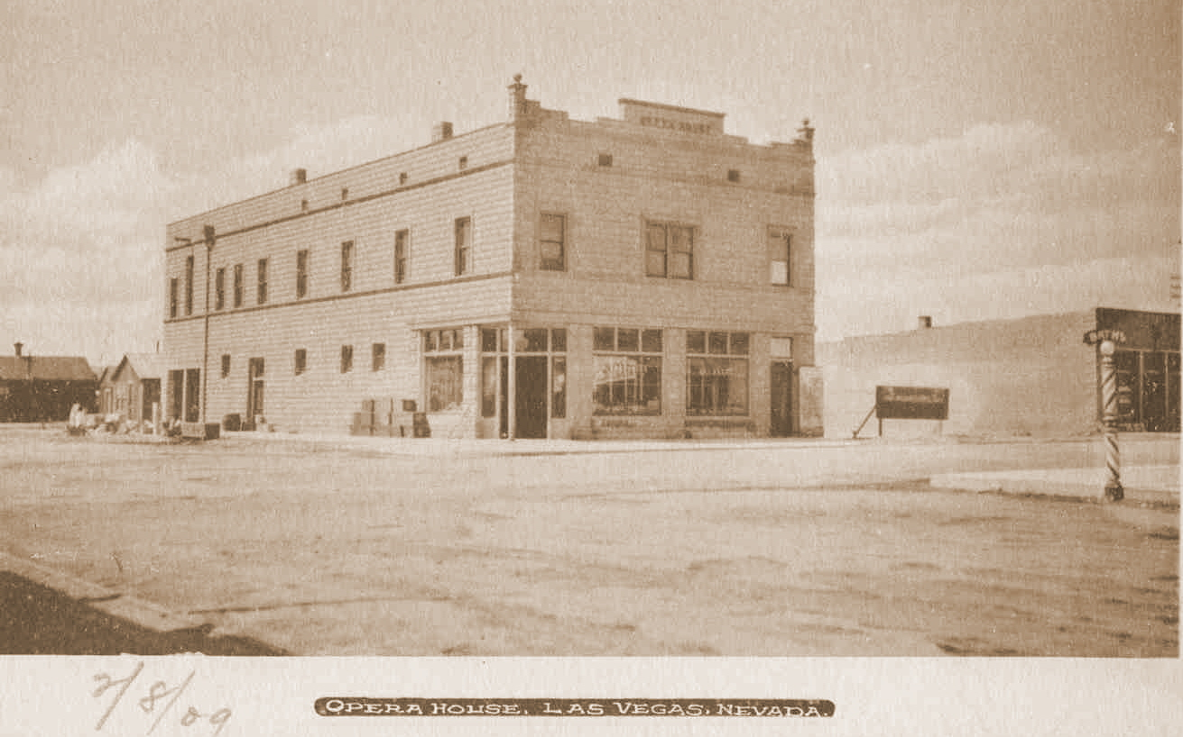
Colonies set up as a gathering place for new immigrants and for commercial purposes
Sugar House:
Production of goods
Las Vegas:
Missions to Indians
Opera House, 1909
Sugar Factory

Slide 10
Called to Settle a New Place
Brigham Young “called” or assigned people to settle in a new place
People were often chosen for their skills
Pioneer home in Manti, Utah

Slide 11
End of the Gathering
More Protestants and Catholics moved into Utah from other states and countries
Official church immigration ended in 1913

Slide 12
Others Start Coming
What caused lots of people to start moving through Utah?
California Gold Rush 1849
Many decided that they’d stay in Utah

