Slide 1
Mining in utah

Slide 2
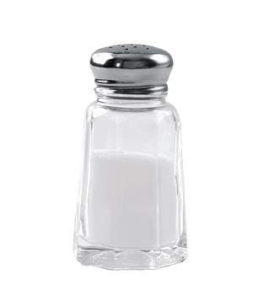
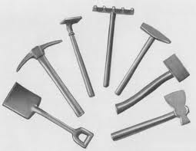
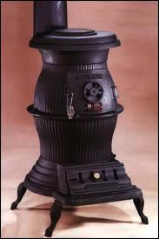
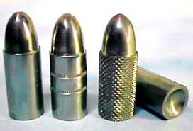
Early Years in Utah
Early settlers focused on farming
Only mined what they needed
Salt for food, Coal for stoves, Iron for tools, Lead for bullets

Slide 3
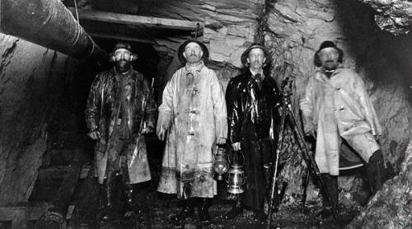
Mining=Money
Railroads made mining
more profitable:
Ore could be shipped
to rails
Many ethnicities,
religions, and
nationalities came to mine
Paid $3-$4 a day for 10 or 12 hours of labor, 6 days a week

Slide 4
Miner’s Life
Dangerous
People could fall from deep mine elevators
Get hit by falling rocks
Run over by mining cars
Tunnels could collapse
Lung Diseases from breathing in dust
Mine could be filled with deadly gasses
http://www.youtube.com/watch?v=jIfu2A0ezq0&feature=kp

Slide 5
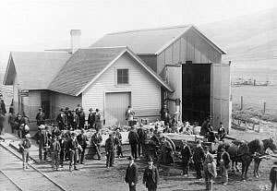
Scofield Mine Disaster
Mine explosion in 1900- killed over 200 men
Important: Worst mining accident @ the time
Every family in Scofield, UT affected
107 Widows, 268
fatherless

Slide 6
Brainstorm Survivor

Slide 7
Your Paper
You have one minute to think of as many things that the Mormon pioneers did or saw when settling Utah:
Things they had to face/overcome
What they did to better the environment and make it more accessible
How did they lay out the cities?

Slide 8
My List
Desert
Isolated
Grid pattern for streets
Very wide streets
Large city blocks
Square in center of town (temple or park)
Farmlands beyond the city
Irrigation
Forts
Road in canyon
Leaders of Church=Leaders of Government
“Called” to settle

Slide 9
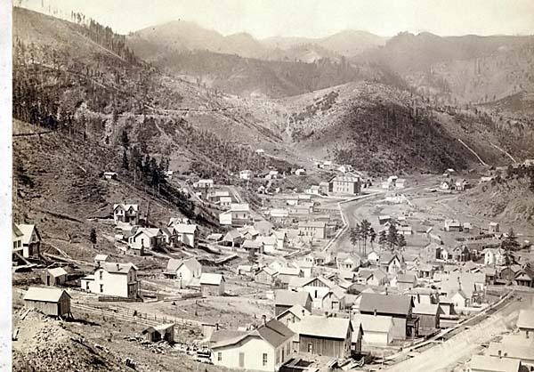
Mining Towns
Features
Town built without a set plan
Narrow & winding streets
In canyons
next to mines

Slide 10
Mining Town Atmosphere
Shacks
Saloons
Gambling Halls
Company store w/ higher prices- only option, so miners were in debt to the company

Slide 11
Transcontinental Railroad
Cause & Effect

Slide 12
Positive Effects
Mining easier- make more money
Faster to travel
Cheaper products from other areas
Spread technology faster

Slide 13
Negative Effects
Competition from stores outside Utah
Native Americans lose land
Train robbery- Butch Cassidy

Slide 14
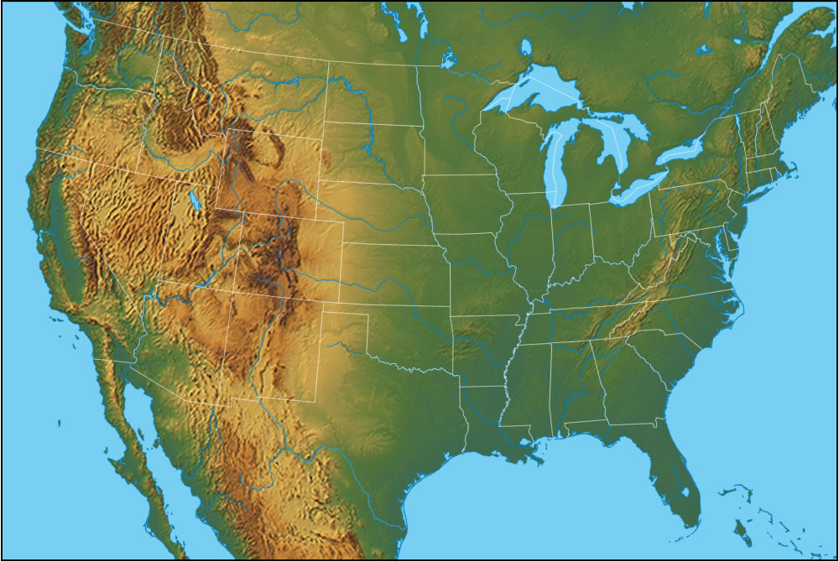
Why does no one live in the middle?

Slide 15
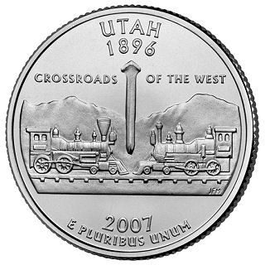

Slide 16
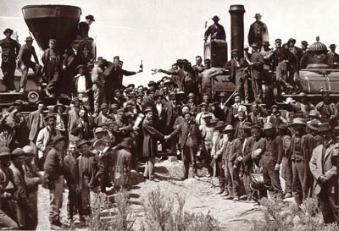
Golden Spike 1869
Central Pacific & Union Pacific Railroads met @ Promontory Summit

Slide 17
Why Utah?

Slide 18
Why Utah?
Central Pacific & Union Pacific in a race to see who could lay down the most track
Sierra Nevada Mountains slowed down Union Pacific
Utah became the meeting place

Slide 19
Who built the railroad?
Chinese and Irish

