Slide 1
Prehistoric People of Utah

Slide 2
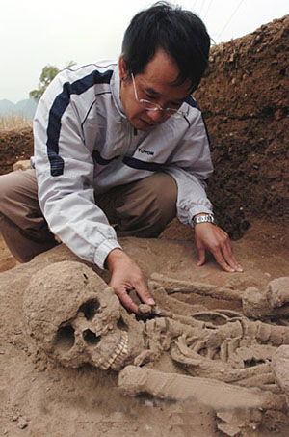
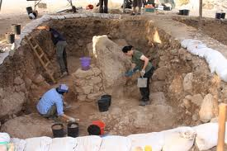
Archaeologists
Study early people using artifacts

Slide 3
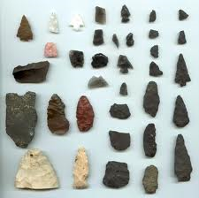
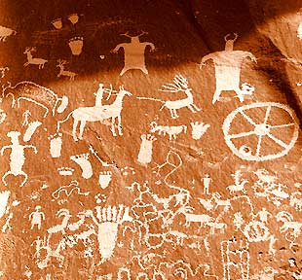
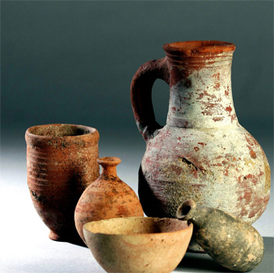
Prehistoric People
Have no written language, but we know about them from artifacts, drawings, oral histories

Slide 4
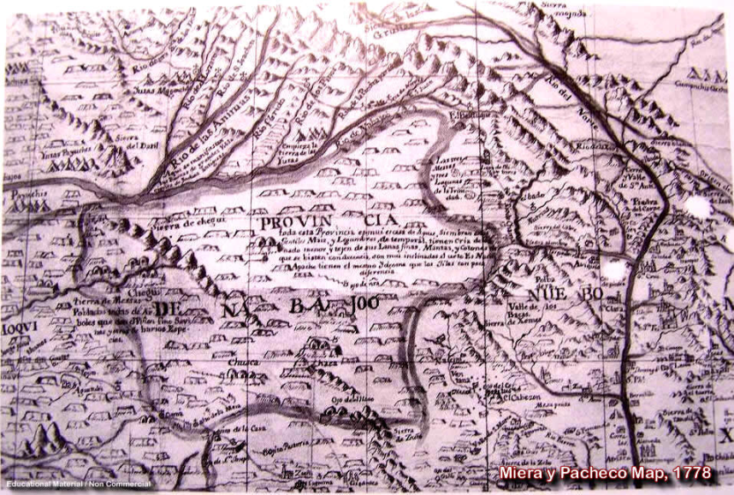
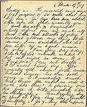
Historic People
Have written records
They may have written the records themselves, or someone who interacted with them may have written them

Slide 5
Archaic People
Lived all over Utah in temporary homes called wicki-ups: shelters made of tree branches and limbs
Desert gatherers
Gathered all kinds of plants and animals
Made baskets for gathering things
Wove ropes and blankets (used yucca plants)
More advanced tools for hunting= the atlatl: a spear thrower that was held over the shoulder and used to launch the spear forward
Allowed the spear to go farther faster and stronger

Slide 6
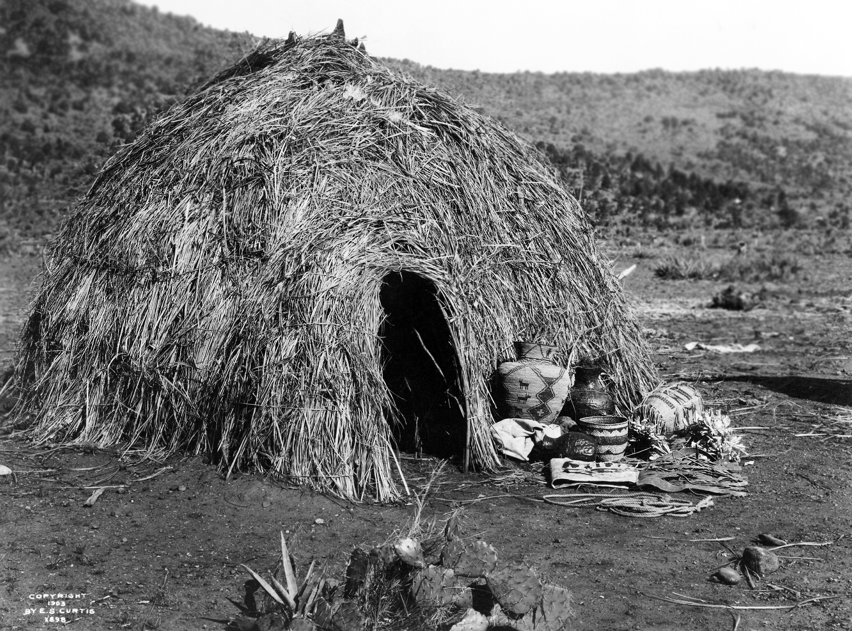
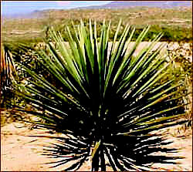
The Wikiup and the yucca plant

Slide 7
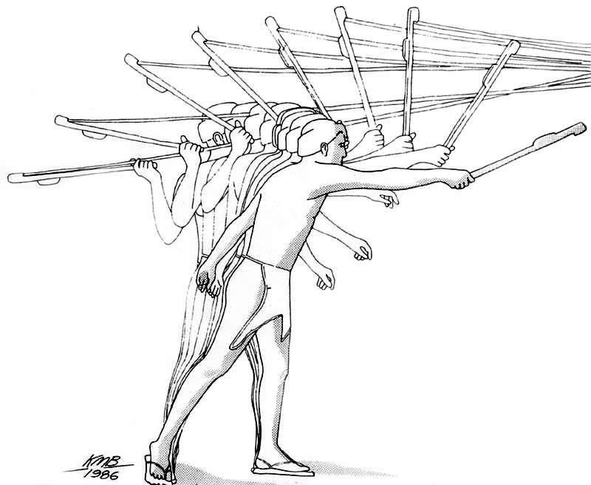
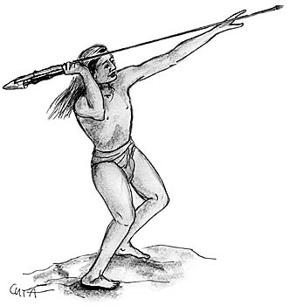
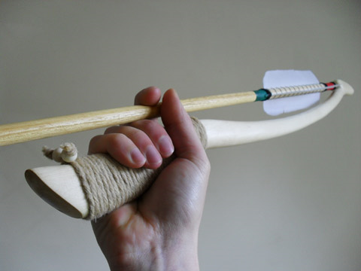
The Atlatl

Slide 8
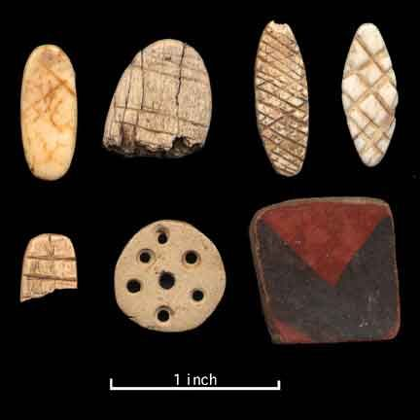
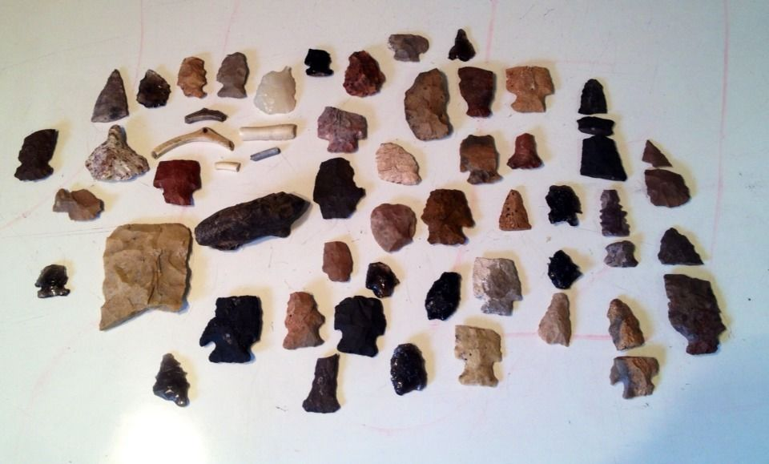
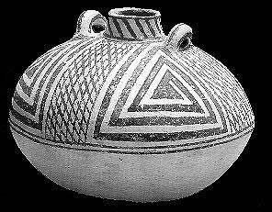
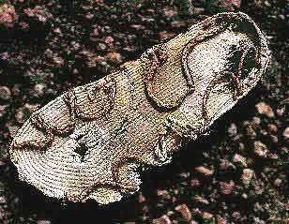
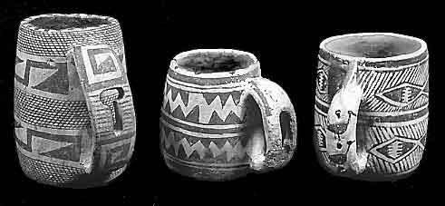
Anasazi

Slide 9
Anasazi
Lived in permanent villages in the four corners area
Hunted, gathered, had small farms, raised turkeys
Developed the bow and arrow
Built dams to store water and used irrigation
Lived in pit houses and cliff dwellings

Slide 10
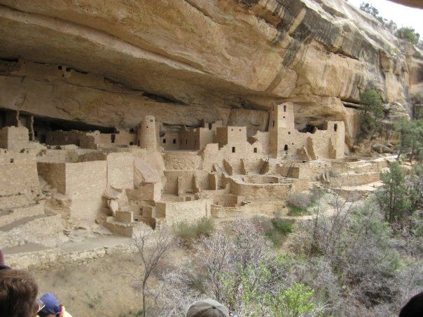

Slide 11
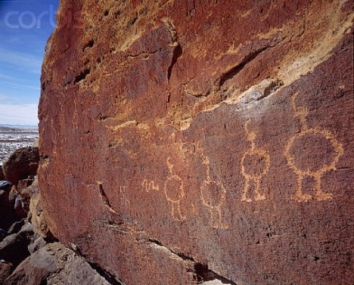
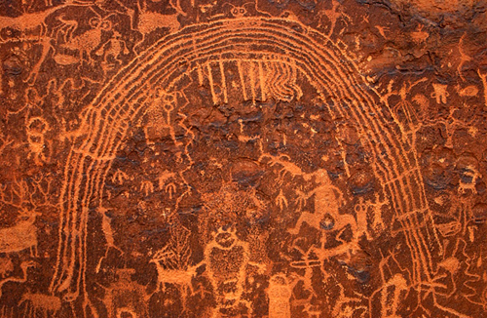
Fremont People
Lived in the valley of the Great Basin
Were farmers, hunters, and gatherers
Lived in pit houses
Lived in canyons near rivers
Remembered for their cave drawings

Slide 12
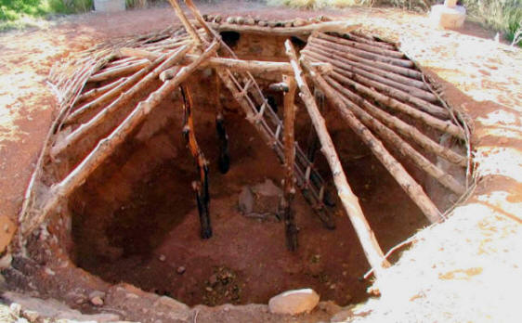
Pit house

Slide 13
Houses
What do houses have to do with where they live?

Slide 14
End of the Fremont and Anasazi
Fremont: left villages and became nomadic
Anasazi: moved to New Mexico and then disappeared mysteriously
Why did they change their lifestyles and disappear?

Slide 15
Primary or Secondary
Primary Sources: Information that is close to the person or event being studied
Ex. Stories told by them, pictures of an event, things used by a person, interviews with a person, books written by the people etc.
Secondary Sources: Information that talks about the person or event being studied
A book about the event/person, textbooks, etc.

