Slide 1
The Trek West
Which way would you have chosen to cross the plains?

Slide 2
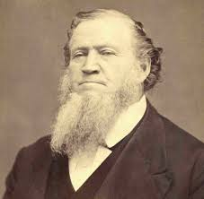
Brigham Young
He became the leader of the LDS church after Joseph Smith died in Illinois.
He led the Mormons from Illinois to the Great Basin
He established more than 300 settlements

Slide 3
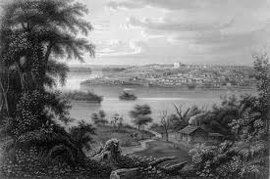
Nauvoo
City in Illinois built up by the Mormons
Was the capital for the Mormon Church
Mormons moved there after Governor Bogg’s extermination order forced them to move from Missouri
Mormons leave Nauvoo to trek west

Slide 4
Extermination Order
A law that forced Mormons to move from Missouri or be killed
Was written by Governor Boggs

Slide 5
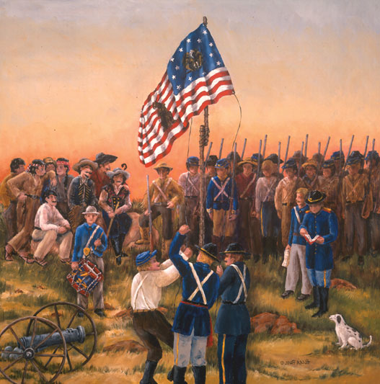
The Mormon Battalion
In 1846 Mexico still owned much of the West. The U.S. went to war with Mexico and asked the Mormons to send troops to help fight against them.
This helped them because the pay from the government helped some families buy supplies that they needed to travel West.
They didn’t really fight.

Slide 6
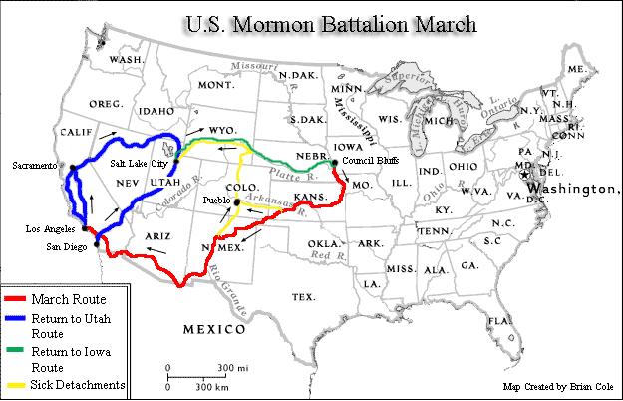
Mormon Battalion Route

Slide 7
The Donner Party
Left Illinois to go to California
Decided to use Hastings Cut-off which was a “shortcut” through Utah.
Didn’t have enough supplies for the harsh conditions
Suffered through heat, and then snow storms in the Sierra Nevada mountains
Some of them ate meat from the bodies of those who had died in order to survive.

Slide 8
Four Immigration Eras
1847 | Covered wagons pulled by oxen
1856-1869 | Handcarts pulled by people
1861-1869 | Down and back wagon trains
1869 | Steam locomotives

Slide 9
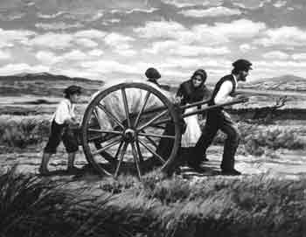
Emigrant vs. Immigrant
Emigrant = a person leaving a place
Immigrant = person coming to a place

Slide 10
Covered Wagon Era
A horn blew to signal the beginning of a new day on the trail.
For fuel they sometimes burned dried “buffalo chips”(buffalo droppings).
Women cooked (soda biscuits, cornmeal johnnycakes, beans)
Stopped at midday to eat and rest
Continued travel sometimes into the late night.
Tried to keep life on the trail like it was at home.

Slide 11
Problems on the trail:
Cold weather
Crossing rivers
Rugged mountains
Disease
Indians

Slide 12
What did they do for fun?
Sang
Danced
Held parties
Went hiking

Slide 13
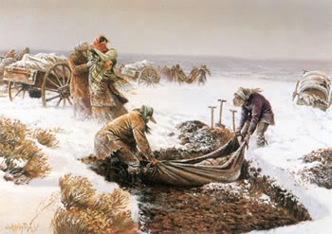
Handcart Era
Purpose:
Cheap and efficient way to bring people to Utah
3,000 Latter-Day Saints came across the plains with handcarts!!
Martin and Willie Handcart Companies:
worst disaster in the Mormon
trek to Utah
280 of 980 members died

Slide 14
Down and Back Wagon Train Era
Brigham Young devised another way to help converts come to Utah
Young men would go on “special missions”
Go to pick up converts
Give them supplies and wagons

Slide 15
Perpetual Emigration Fund or PEF
Purpose:
Helped Mormon converts emigrate from their homelands to Utah
How it worked:
Money, supplies, and food were donated to help converts come to Utah
Immigrants later repaid their “loans” to PEF

Slide 16
Documents from the PEF

