Slide 1
Mountain Men
Chapter 4

Slide 2
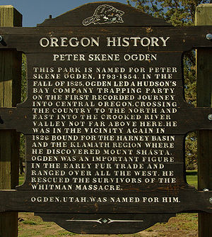
Peter Skene Ogden
Other Facts: Called Ogden a hole because it was surrounded by mountains
Ethnicity: American
Company: Hudson’s Bay Company (British)
Location: Cache Valley and Ogden
Accomplishments:
One of the earliest written accounts of northern Utah in his journal.
Ogden and Ogden River named after him

Slide 3
Jim Bridger
Ethnicity: American
Company: Ashley-Henry Company
Location: Northern Utah
Accomplishments:
Took a boat from the Bear River to Great Salt Lake and explored it.
First to see Great Salt Lake
Built trading posts where travelers could buy supplies.
Other Facts:
Great story teller
Traded one fat cow for 2 or 3 skinny cows with travelers, then fattened them up and sold them too.

Slide 4
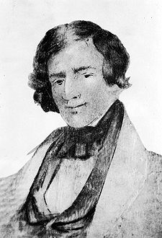
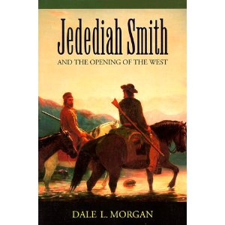
Jedediah Smith
Accomplishments:
Leader among trappers
First to travel the length and width of Utah
Proved that no rivers flowed from the Great Salt Lake to the ocean
Ethnicity: American
Company: Ashley-Henry Company
Location: All over Utah
Other Facts:
Carried a rifle and a bible
Attacked by a grizzly (tore off his ear)
Survived traveled in California by burying self in sand
Prejudiced against natives
Killed by natives

Slide 5
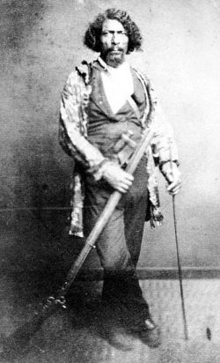
James Beckwourth
Accomplishments: Explorer, trapper, miner, army scout, and businessman
Wrote a book about his life
Ethnicity: African American
Company: Ashley-Henry Company
Location: All over the west
Other Facts
Former slave in Virginia
Adopted by tribe of Crow Indians.
Married a Crow woman
Great story teller

Slide 6
Etienne Provost
Accomplishments:
Also recorded as first to see Great Salt Lake
Led important expeditions
Established trading posts
Ethnicity: French
Company: New Mexico
Location: Utah Valley
Other Facts
Provo and the Provo River are named after him
(While smoking peace pipe) Attacked by natives in the first reported clash between natives and non-natives.

Slide 7
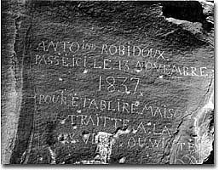
Antoine Robidoux
Accomplishments:
Built forts and trading posts (Fort Robidoux was among the Utes)
Ethnicity: French
Company: New Mexico
Location: Uinta Basin
Other Facts
Carved a message into a Rock

Slide 8
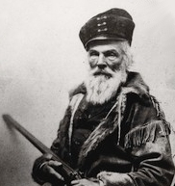
Joseph R. Walker
Ethnicity: American
Company: None
Location: All over the west
Accomplishments:
Trapper and guide for pioneers
Established the main trail for movement to California due to his published reports
Other Facts
Walker was not the first to use the Walker trail, but his writings made it popular

Slide 9
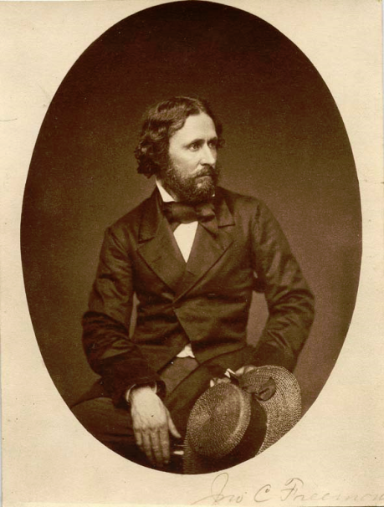
John C. Fremont
1841
Accomplishments:
Worked for Army Corps of Topographical Engineers and learned about astronomy, plants, mining, and record making
Hired to explore and map the Oregon Trail
Writings inspired people to move west
Published a book with errors: Great Salt Lake and Utah Lake were same body of water, Utah was a garden spot, fertile and well watered.
These mistakes led Mormons to want to settle there
Contributed valuable info about Utah

Slide 10
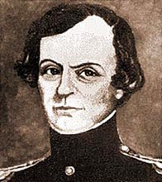
John W. Gunnison
1849
Accomplishment:
Sent by government to explore the Great Salt Lake
Wrote a book about Mormon people
Sent to find best route for the transcontinental railroad and decided it should go through WY and northern UT, not central UT
Established a southern route to California
Established a military road to Utah
Killed by natives

Slide 11
John Wesley Powell
The one-armed explorer of Colorado and Green Rivers

Slide 12
What did they do all year?
During fall, winter, and spring, mountain men tended to their traps
Cache: a hole they’d dig to hide furs in. They’d cover the holes with dirt, large rocks, and brush

Slide 13
Rendezvous
Trappers, traders, and Indians got together every year at Rendezvous
Mountain men only trapped 20 years, ended because
Beaver died out
Beaver hats weren’t fashionable in Europe anymore
Rendezvous was a time for business and fun
Mountain Men impact: paved the way for more white settlers to come west

