Slide 1
Ch. 12 Utah Life Reflects the Nation
Immigrants, Technology, Mining, National Parks

Slide 2
Immigrants
Came to find jobs
Group together with other immigrants to cope with the isolation of being strangers
Jobs- got paid less, or could find no job
Who did you let come to Utah?

Slide 3
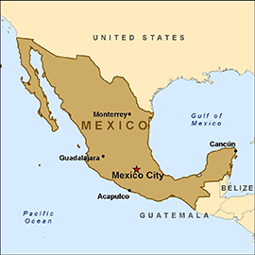
Mexican Immigrants
1910 Mexican Revolution caused thousand to leave
Majority- worked in mines, mills, railroads, or seasonal migrant worker
Mexican colonias (communities)

Slide 4
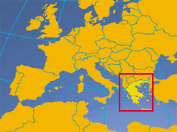
Greek
Came to work in mines
1st unmarried men, later Greek brides were sent to Utah
Greek Orthodox Churches built in Salt Lake

Slide 5
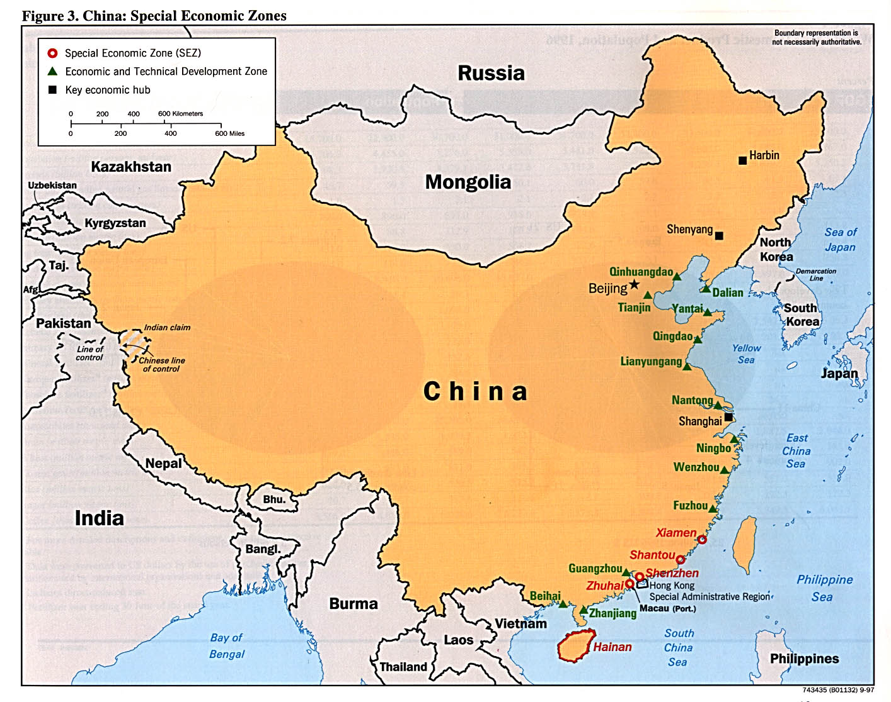
Chinese
A lot stayed after working on the railroad
Others worked in mines or set up small businesses

Slide 6
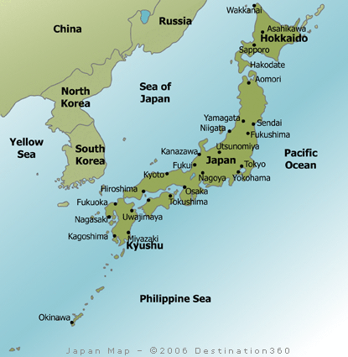
Japanese
Mines- 800 @ Bingham, 1,000 @ Helper & Price
Most were farm laborers
Utah celery & tomato crops, and sugar beet industry became dependent on Japanese

Slide 7
Jews
52 families started community near Gunnison, UT (central UT)
Colony failed- poor land, lack of water
Only 12 families stayed and became chicken farmers

Slide 8
African Americans
Discrimination in Utah
Lower wages
Mixed race couple could not get a marriage license
Could only live in certain parts of town
Not admitted to Lagoon, most restaurants or hotels
Ku Klux Klan

Slide 9
Advancing Technology
Electric trains- main source of transportation until cars
1896 Utah begins using electricity
Streetlights, mines, city businesses, and then to homes
Rural areas had to wait a long time for electricity

Slide 10
Mining
Copper, Coal, Silver, & Gold
Smelter- a place where metal is separated from rock, usually by heat.
Daniel Jackling
founder of Utah Copper Company (Kennecott)
Developed the open-pit mining method

Slide 11
Preserving the Land and water

Slide 12
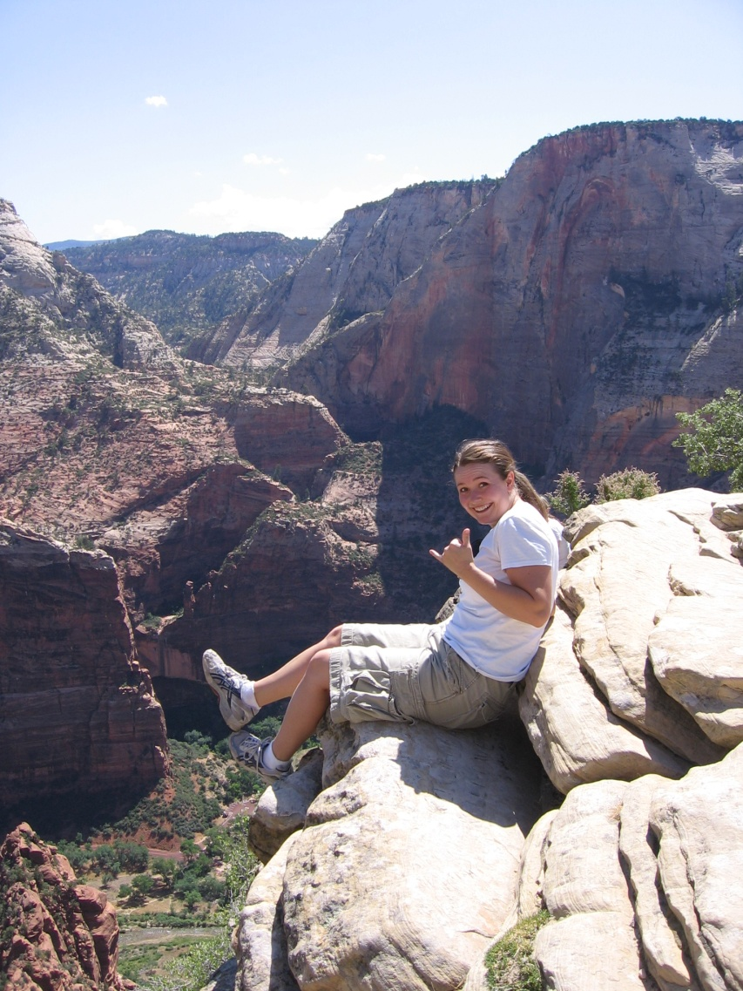
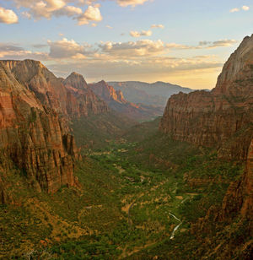
National Parks and Monuments are created
Natural Bridges National Monument (1st)
Rainbow Bridge National Monument
Dinosaur National Monument
Zion National Park (1st)

Slide 13
Strawberry Reservoir
To provide more water in Utah County they build a concrete tunnel over 3 miles long to connect the water from the Strawberry river to the Spanish Fork River
They had to create a dam which would cover a lot of land previously used for cattle grazing.
The land was taken from the Utes who had been renting it to ranchers for grazing…

Slide 14
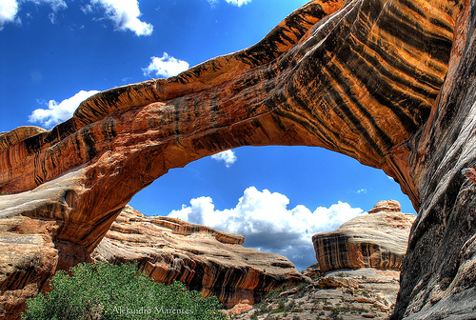
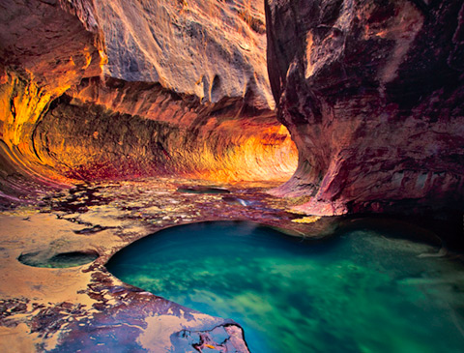
National Parks & Monuments
Water shortage problems- dams built
National forests created- important watersheds
1908 Natural Bridges National Monument- 1st national monument in Utah
1918 Zion National Park- Utah’s 1st national park

