Slide 1
How a Bill Becomes a Law in Utah

Slide 2
Step 1: Idea
Legislators need an idea!
Ideas come from:
Legislators’ experiences
Utah Citizen
Special Interest Groups or Lobbyists

Slide 3
Step 2: Drafting a Bill
Utah legislators get help from lawyers while they write their bills

Slide 4
Step 3: Bills Read
Once Bills are written, they need to be read to Congress (either the House of Representatives or the Senate)
After they’re read, bills are given a name and number and sent to committees

Slide 5
Step 4: Committees Can…
Amend: Make changes to the bill
Substitute: Replace the bill with an entirely new bill that is about the same topic)
Hold: Take no action
Table: Decide not to deal with the bill until the next meeting
Pass the Bill: pass the bill…Now it can be introduced to the rest of the Senate/House

Slide 6
Step 5: Bills are read to Legislators
Can happen in Senate or House of Representatives
Bills are read, including their title and number
The sponsor will explain the bill and answer questions from legislators
All members of Congress will make changes to the bill (they have to be relevant!) or substitute the bill for another one
Legislators vote on the Bill—Majority wins!

Slide 7
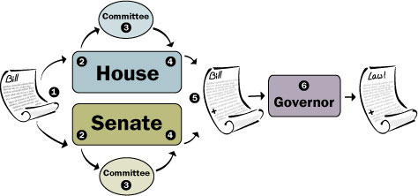
Step 6: Bill presented to other house
…It has to be passed in the other house.
In other words: A Bill has to pass the Senate and the House of Representatives

Slide 8
What if a Bill doesn’t pass both houses?
That bill doesn’t get to become a law!

Slide 9
Step 7: Bill is signed by leaders of both houses
This is called “Enrolling” and helps to get the Bill ready to send to the Governor

Slide 10
Step 8: The Governor Decides
The Governor has 20 days to choose if he wants to:
Sign the Bill (Makes it a law)
Not sign the Bill (It won’t be a law)
Veto the Bill (It won’t be a law)

Slide 11
Step 9: What if both houses want the Bill to become a law?
If both houses has 2/3 of people vote to make the Bill a law, they override the Governor’s veto.
The Bill can be a law!

