Slide 1
The Great Depression and The “New Deal”
Utah History

Slide 2
A World Wide Depression
1929-1941- Economic hard times
Overproduction of goods, bank failures, and a stock market crash caused the Great Depression
People were optimistic in the 1920’s and borrowed money. There was so much business on credit, that the stock market “crashed” in 1929.
The economy went downhill, banks closed, business couldn’t borrow money, factories cutback, jobs were lost—people were unemployed. Unemployed people couldn’t spend money- rough cycle.

Slide 3
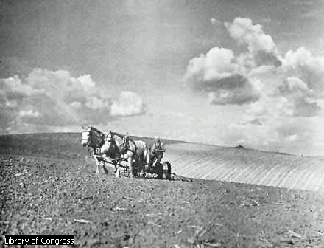

Slide 4
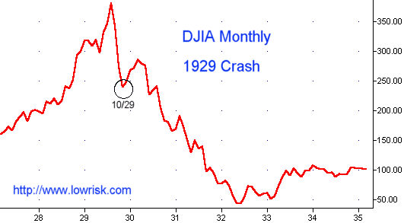
The Market Crash of 1929

Slide 5
Why did banks fail?
Banks make money by charging interest on loans and investing money people put in savings.
When companies/or people could not pay back loans—the banks had to stop giving out more loans
People had to withdraw their money to live on and therefore the bank had no income and had to shut down.

Slide 6
Bank Failure
What is a bank run?
People with savings accounts took their money out of the bank to live on because they didn’t trust it in the banks.

Slide 7
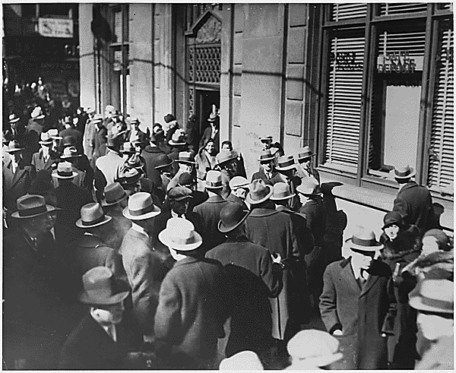
A Bank Run in 1933

Slide 8
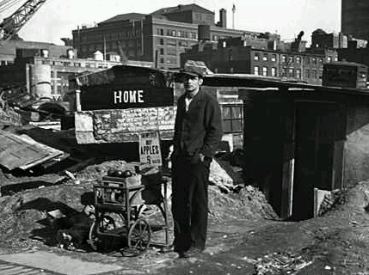
A jobless man sells apples on the streets of New York City in 1932. More than 15 million people, nearly one quarter of the United States work force, were unemployed by 1932, three years after the stock market crash that signaled the beginning of the Great Depression.

Slide 9
Suffering Ethnic Groups
Native Americans- more dependent on the federal government. 1934-indian reorganization Act… allowed Native Americans to choose their own leaders and make their own laws.
Hispanics—4,000 Mexicans living in Utah… first loose their jobs- went back to Mexico.
African Americans- Worse than ever… some lived in holes
Other groups Chinese, Italians, and others struggled to get jobs.

Slide 10
Utah and the Great Depression
Utah was one of the hardest hit states in the Great Depression!
  Had a high unemployment rate
  Farmers did not make as much money on crops

Slide 11
Images of the Great Depression
As we look at the following slides, prepare to write your interpretation of what the Great Depression felt like to the people who lived it!
Watch the faces and look at the towns, buildings….

Slide 12
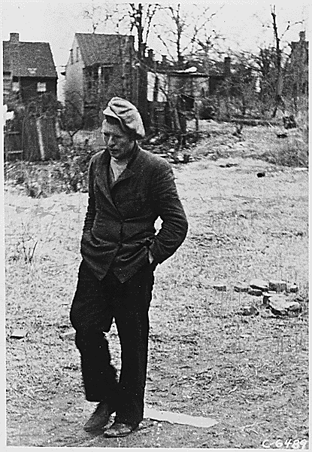
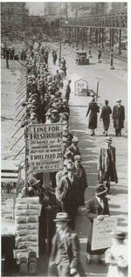

Slide 13
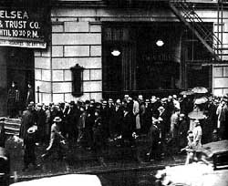
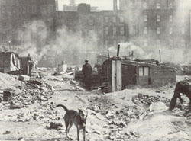
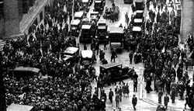
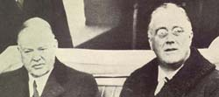
Chicago Hooverville
A bank run
Wall Street
Hoover and FDR in 1932

Slide 14
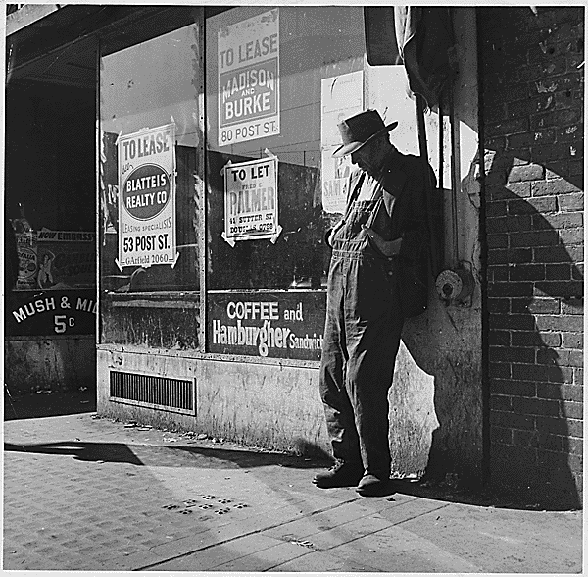

Slide 15
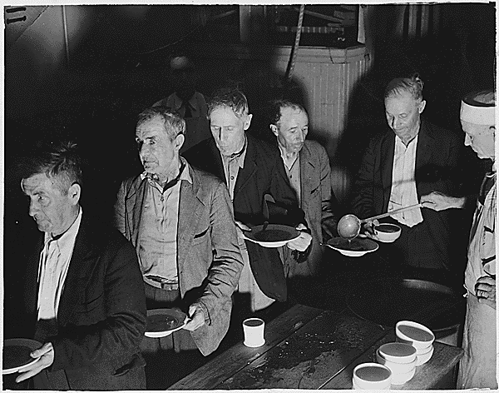
A soup kitchen – Free Food for the Homeless!

Slide 16
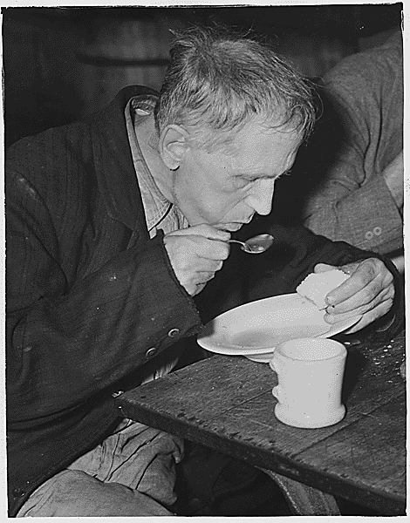

Slide 17
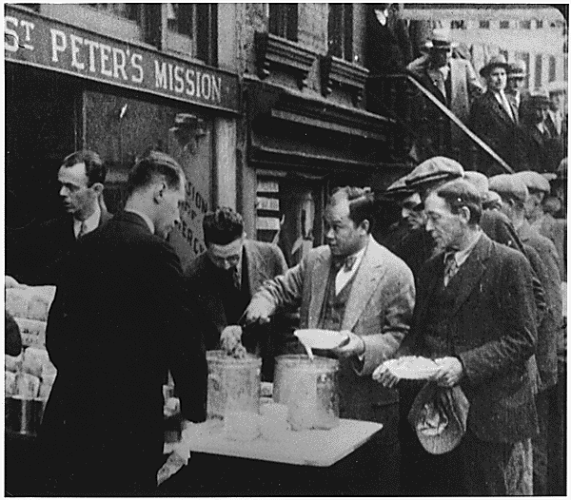

Slide 18
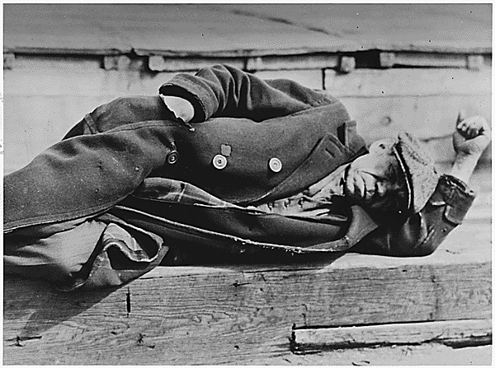
A Vagrant – Hobo – Bum – Homeless and Hopeless in the 30’s!

Slide 19
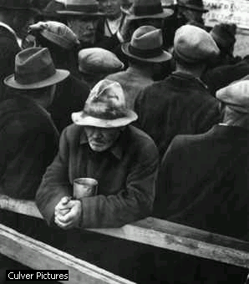

Slide 20
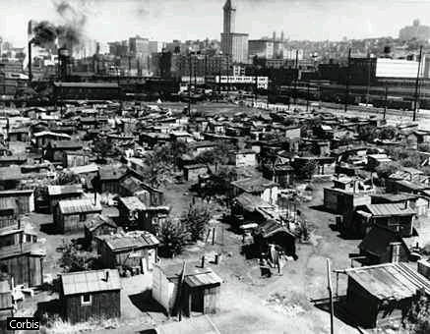
Shantytowns formed in cities across the United States in the 1930s, built by people made homeless by the Great Depression.
    The areas, like this one in Seattle, were nicknamed Hoovervilles because their inhabitants blamed President Herbert Hoover for their plight.

Slide 21
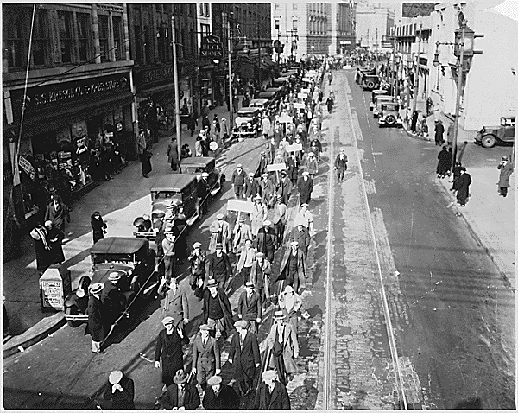

Slide 22
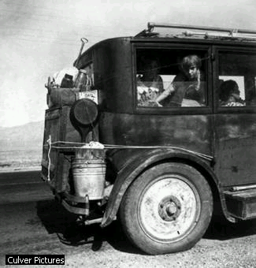
    Thousands of farmers and their families left the southern Great Plains region of the United States during the Great Depression, after severe wind erosion earned it the label Dust Bowl.
Many of these refugees sought work and a better life in California.
John Steinbach's classics: The Grapes of Wrath or Of Mice and Men.

Slide 23
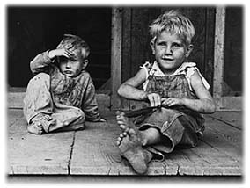
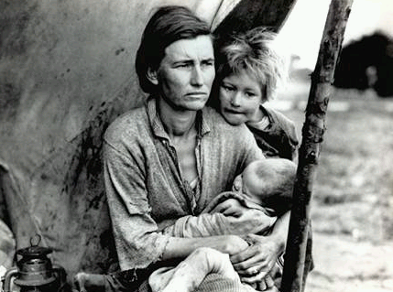

Slide 24
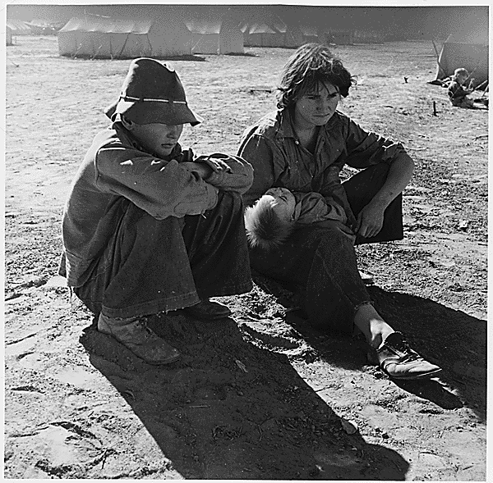

Slide 25
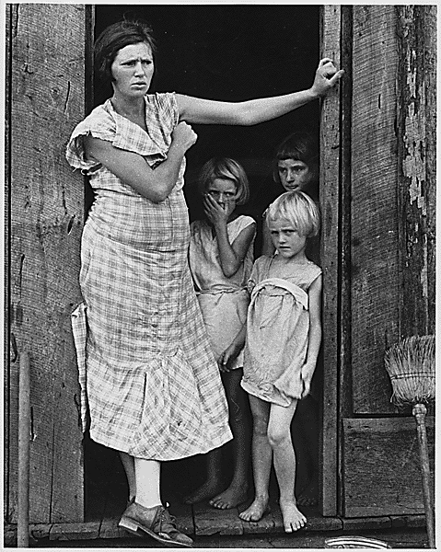

Slide 26
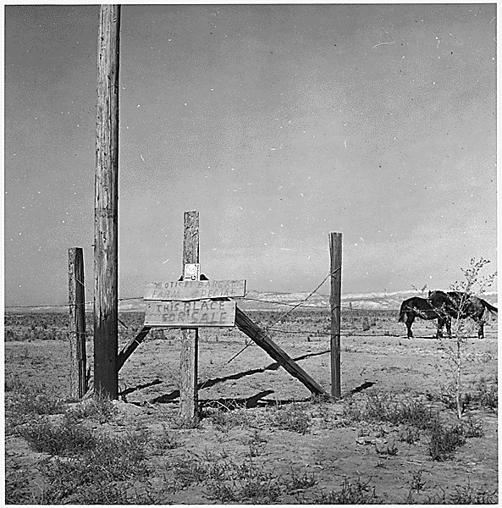

Slide 27
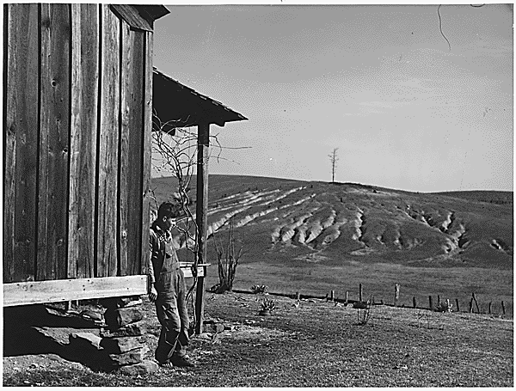

Slide 28
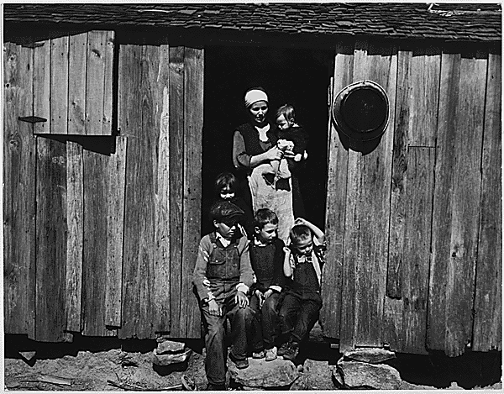

Slide 29
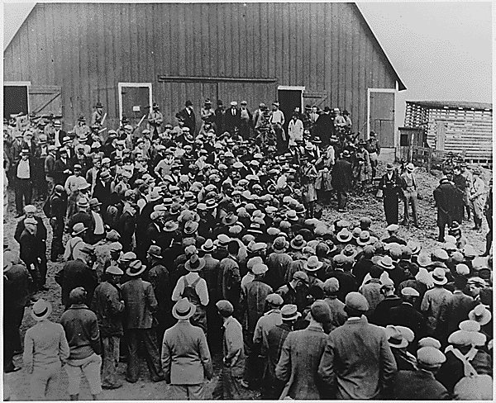
Foreclosure by Auction

Slide 30
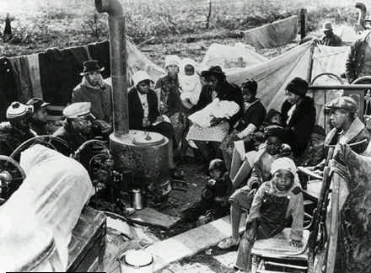
Sharecroppers evicted from their homes camp along a highway in rural Missouri in the 1930s. The Great Depression left many Americans— urban and rural, black and white— without homes, jobs, and hope.

Slide 31
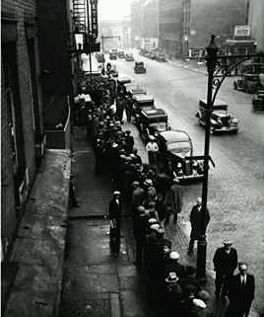
    The Great Depression forced many Americans to go hungry or depend on charities for food, clothing, and other necessities. Here, people wait in a breadline to receive free food.

Slide 32
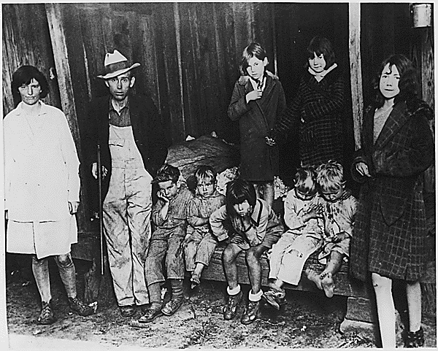

Slide 33
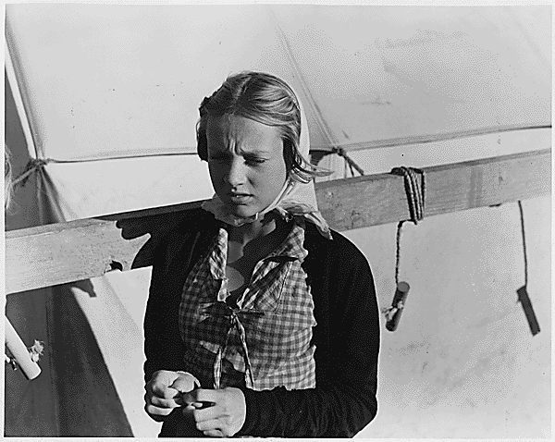

Slide 34
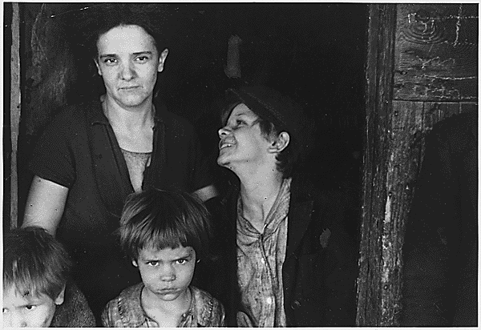
Who is the coal miner and bread winner in this family?

Slide 35
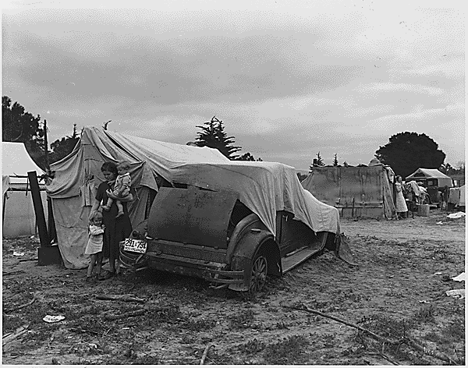

Slide 36
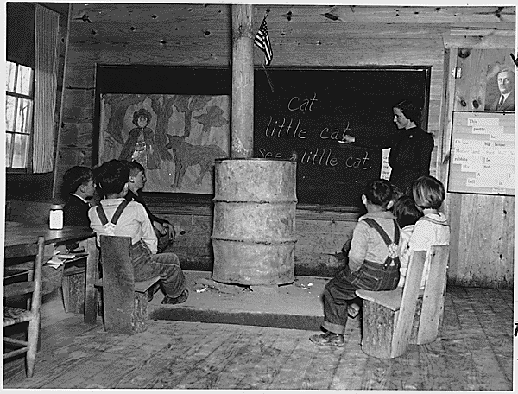

Slide 37
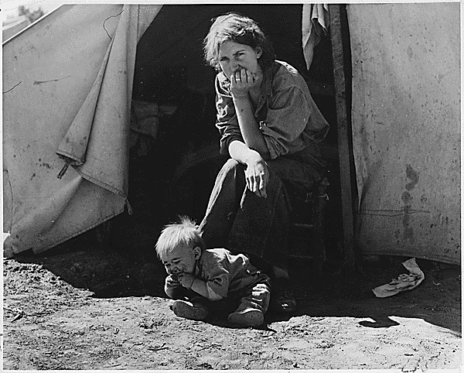
Mom is 18 years old. Does she look 18?

Slide 38
Utah’s Great Drought of 1934
In 1934 rainfall was only 51% normal. Utah Lake was 1/3 its usual amount.
Sheep, cattle, and farms were desperate
Governor Blood asked for financial help from the Federal Emergency Relief Administration(FERA)
President Roosevelt responded within 36 hours of being asked for help.
The federal government sent thousands of dollars to dig wells, irrigation ditches, develop springs, and lay pipeline to carry water.

Slide 39
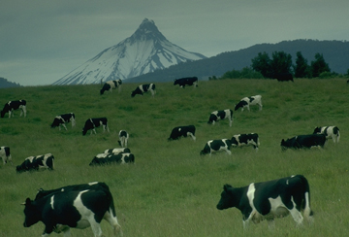
The Great Dust Bowl
Today in America we practice soil maintenance and land management. These programs are born in the 1930’s in the Era of the Great Dust Bowl!

Slide 40
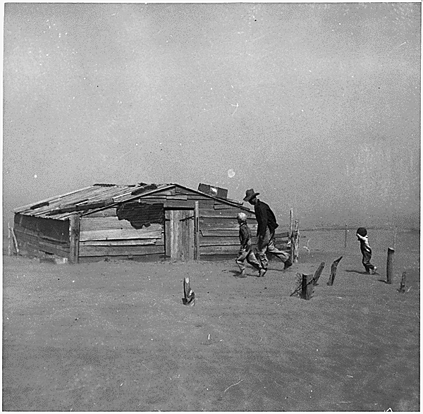
http://www.pbs.org/wgbh/amex/dustbowl/filmmore/reference/interview/melt03.html

Slide 41
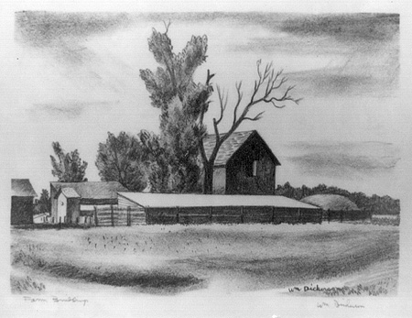
Black Sunday
April 14, 1935, dawned clear across the plains. After weeks of dust storms, one near the end of March destroying five million acres of wheat, people grateful to see the sun went outside to do chores, go to church or to picnic and sun themselves under the blue skies. In mid-afternoon the temperature dropped and the birds began chattering nervously. Suddenly a huge black cloud appeared on the horizon, approaching fast. When the storm hit, those on the road had to try to beat the storm home or stop and seek shelter. The storm on Black Sunday was the last major dust storm of that year. Coming on the heels of a stormy season, the April 14 storm hit as many others had, only harder. "The impact is like a shovelful of fine sand flung against the face," Avis D. Carlson wrote in a "New Republic" article. "People caught in their own yards grope for the doorstep. Cars come to a standstill, for no light in the world can penetrate that swirling murk. . . . The nightmare is deepest during the storms."

Slide 42
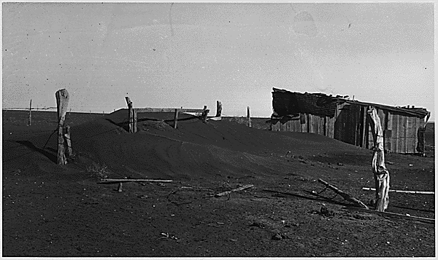
Dirt drifts in the Dust Bowl!

Slide 43
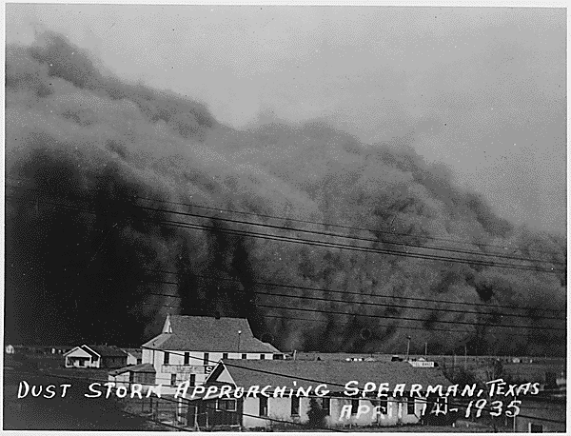
http://www.pbs.org/wgbh/amex/dustbowl/filmmore/reference/interview/glover05.html

Slide 44
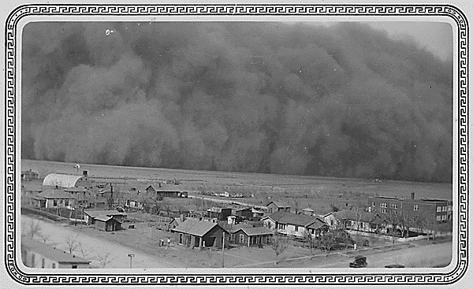

Slide 45
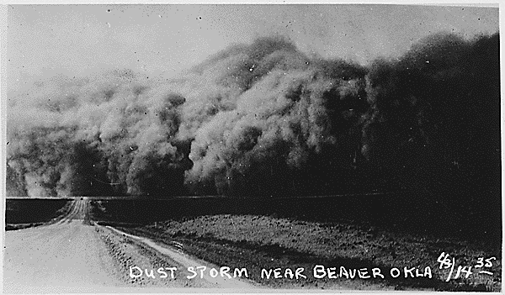
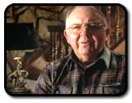
http://www.pbs.org/wgbh/amex/dustbowl/filmmore/reference/interview/davison05.html

Slide 46
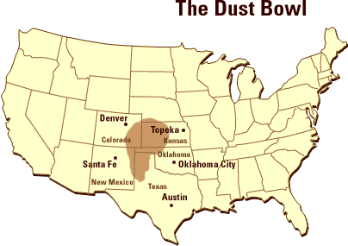

Slide 47
President F.D. Roosevelt creates the New Deal
The New Deal was a Government solution to the Great Depression
President Roosevelt believed the common people had been dealt with unfairly—he wanted to give them “a new deal of cards”.
It provided new jobs for out of work Americans.
  CCC: Young men built roads and trails in the forests, planted trees, built campgrounds, recreation spots etc.
  WPA: Musicians and writers and artists were hired

Slide 48
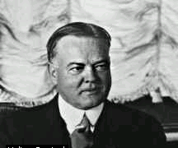
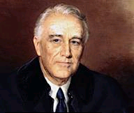
President Hoover and President Roosevelt
“The fundamental business of America is on a sound and even footing!” Herbert Hoover 1929
“The only thing we have to fear is fear itself!”
Franklin Delano Roosevelt March 1933

Slide 49
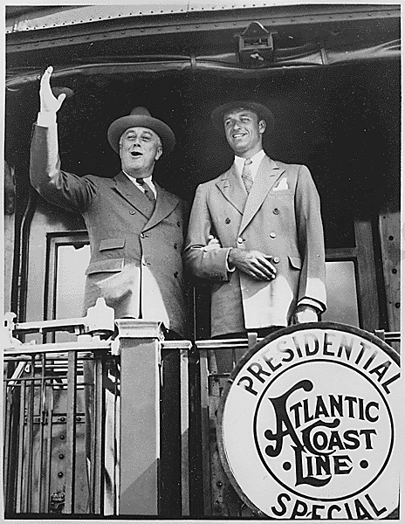

Slide 50
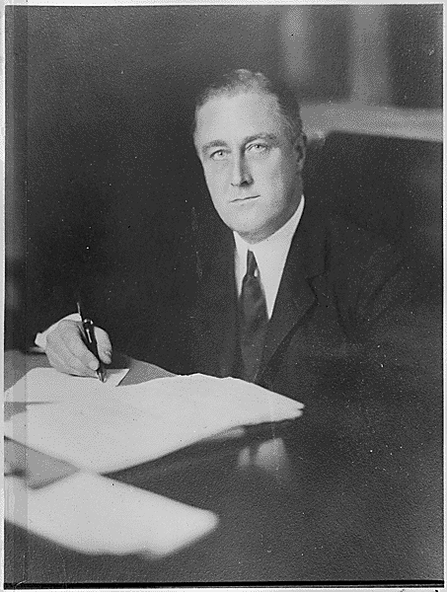
New Deal Programs:
TVA, AAA, CCC, SEC, FDIC, FHA, FSLIC, WPA, PWA, REC, NRA……..
With so many alphabetic agencies created by Roosevelt’s New Deal even the President became known as just FDR!

Slide 51
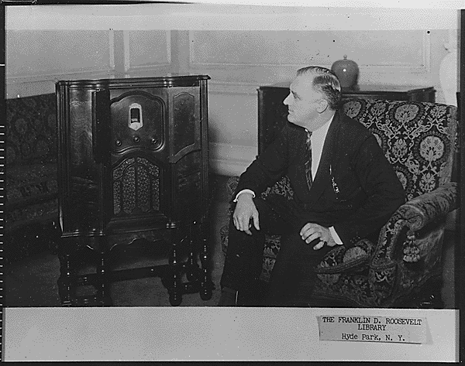

Slide 52
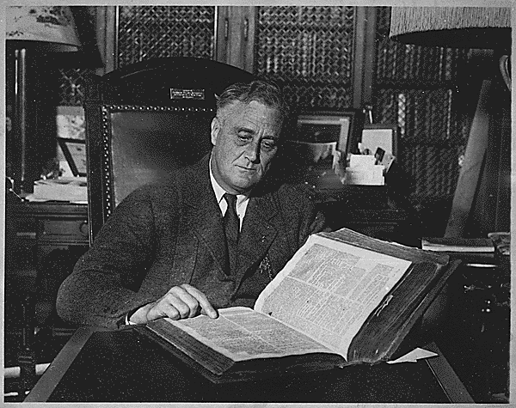

Slide 53

The Beginnings of the Modern Presidency – FDR’s Fireside Chats

Slide 54
More programs of the New Deal
Federal Emergency Relief Administration—A government agency which helped Utah during the 1934 drought, by sending thousands of dollars to dig wells, develop springs, line irrigation ditches, and lay pipeline to carry water.
Civilian Conservation Corps—employed young men, placing them in camps where they lived under Army discipline, building roads, trails and retaining walls in the forests. They planted trees and built bridges, campgrounds, and recreation spots in canyons.

Slide 55

Government Jobs Programs
CCC
WPA
PWA

Slide 56
What did the Government do to help?
Works Progress Administration—
  Started the Utah Symphony during the Great Depression!
  paid men to build highways, roads, streets, new buildings, schools, parks, athletic fields, pools, sewers, water lines, airports and runways.
It set up programs of artists, musicians and writers to make records and works of art, Utah symphony was one of its projects, as well as typing pioneer journals, interviewing pioneer residents, and preserving pioneer photographs

Slide 57
Government and Church Security Plans
Social Security Act of 1935—Set up a system of pensions for the elderly and for people with disabilities, and programs to provide unemployment benefits to workers who lost their jobs.
Farm Security Administration—Moved farmers to better land, funded camps for immigrant farm workers, extended loans at low interest rates to small farmers, sent photographs to make a record of farm life.
LDS Church Security Plan (renamed Welfare Plan)-started by the Mormons included community farms, canning factories, and bishops’ storehouses.

Slide 58


Slide 59


Slide 60


Slide 61


Slide 62


Slide 63


Slide 64


Slide 65


Slide 66


Slide 67


Slide 68


Slide 69


Slide 70


Slide 71


Slide 72


Slide 73


Slide 74


Slide 75


Slide 76


Slide 77


Slide 78


Slide 79

http://rs6.loc.gov/wpaintro/alice.html

Slide 80


Many Solutions to the Depression were possible!

Slide 81
America’s Choice:
The New Deal
FDR’s Plan for economic recovery
Experimental in nature
The New Deal begins the era of big government and the belief that government can and should solve people’s problems!!!

Slide 82



What ended the Great Depression?
American entering World War 2!
  How? Provided jobs to millions of Americans

