Slide 1
Chapter 2 Utah’s Geologic History… How was it formed?

Slide 2
Geologic Eras
There are 4 Geologic eras we will remember…
The Precambrian Era
The Paleozoic Era
The Mesozoic Era
The Cenozoic Era

Slide 3
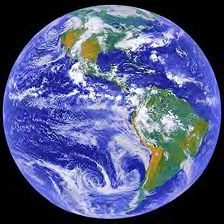
The Precambrian Era
Precambrian Era: 85% of the earths 4.5 billion years were in the Precambrian Era.
The Precambrian era was the LONGEST of the eras

Slide 4
The Paleozoic Era
The Paleozoic Era means “ancient Life”
Fossil Fuels such as Oil, Coal, and Natural Gas were starting to form.
Fossil Fuels are formed by the remains of decaying plants and animals.

Slide 5
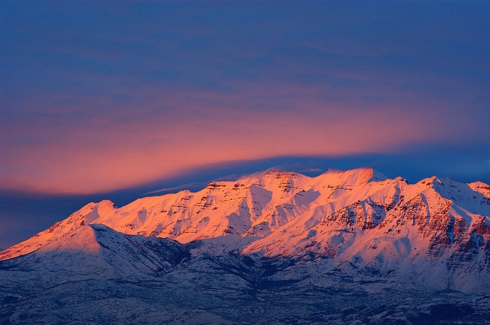
The Mesozoic Era
The Mesozoic Era means “ middle life”.
In the Mesozoic Era Dinosaurs roamed the earth.
The Rocky Mountains were also formed in the Mesozoic era.

Slide 6
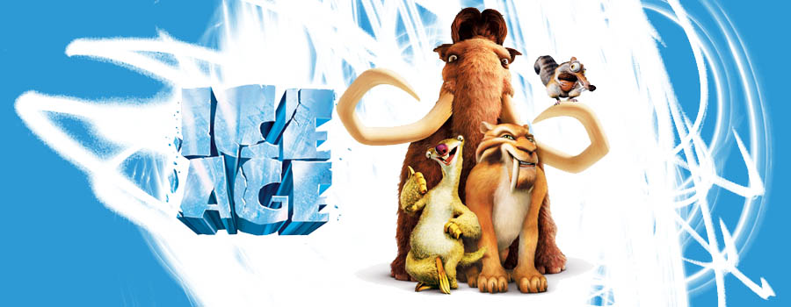
The Cenozoic Era
The Cenozoic Era means “ recent life”.
This is the era that began to shape the earth’s surface to the point where we recognize it today.
Several periods called Ice Ages helped changed the look of the land.

Slide 7
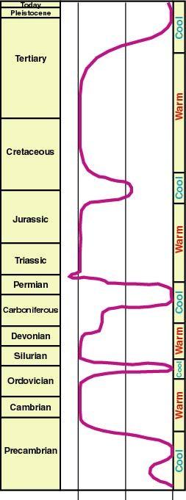
Ice Ages Throughout Geologic Time
Ice Age
Ice Age
Ice Age
Ice Age
22°
17°
12°

Slide 8
Sedimentary Rock
Sediment: Loose sand, pebbles, and shells that are carried by water and drift to the bottom of bodies of water
Sedimentary Rock: Rock formed when sediment is under heat and pressure forcing it together
Lake Bonneville pressed sediment together to form Utah’s sedimentary rock
Some layers of sedimentary rock in Utah are as thick as 1,000 feet
Utah’s national parks are located in the Colorado Plateau Region and formed mostly of sedimentary rock

Slide 9
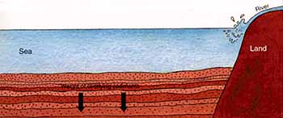
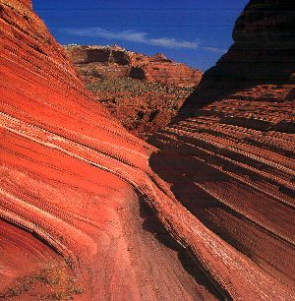

Slide 10
Dinosaurs
Morrison Formation: where many dinosaur bones have been uncovered in Utah
World’s most complete dinosaur skeleton found in Utah!
23 complete dinosaurs found here, 300 partial dinosaurs too
Can see digs happening at Dinosaur National Monument near Vernal, Cleveland-Lloyd Dinosaur Quarry in Emery County, and in Moab
Dinosaur remains turn into fossil fuels: oil, natural gas, coal

Slide 11
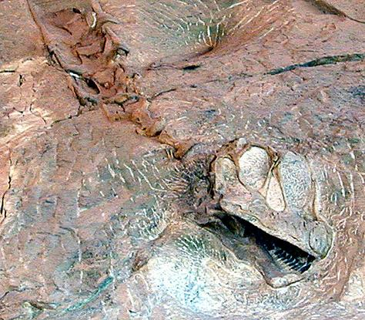
The Morrison Formation

Slide 12
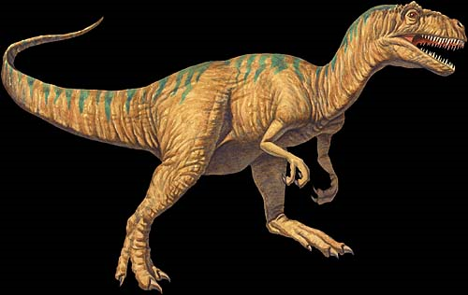
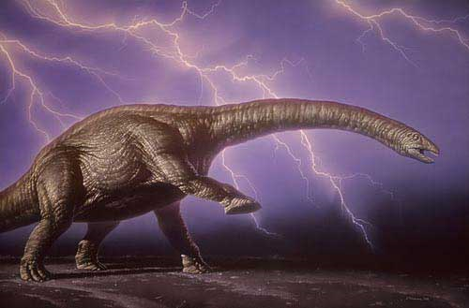
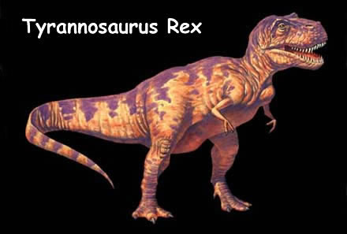
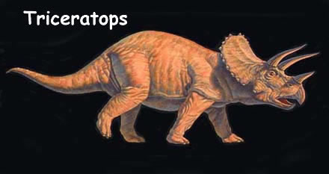
What additional dinosaurs can you find in Utah other than these…

Slide 13
Utah Raptor

Slide 14
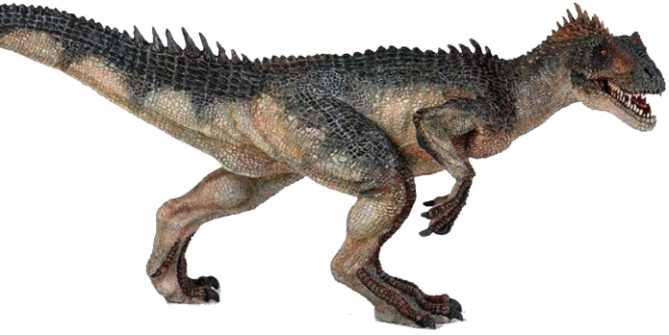
Allosaurus

Slide 15
Allosaurus vs. T-Rex
It was older (by thousands of years)
It was smaller
It had three functioning fingers

Slide 16
Formation of Mountains
Rocky Mountains
Formed by pressure on the North American tectonic plate from the Pacific and Atlantic Ocean floors, causing earthquakes
Earthquakes caused buckling, folding, and cracks (called faults) along North America
Utah was raised up into peaks and cliffs
Mountain sediment was washed into the valleys, leaving the rocky core visible

Slide 17
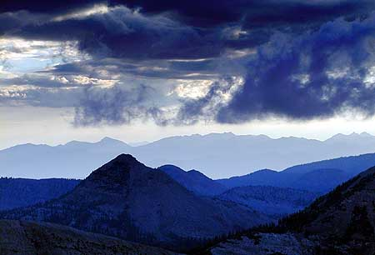
How were Utah’s Mountains Formed?
The Rocky Mountains (Uinta and Wasatch Mtns) were formed from Earthquakes
The Smaller Mountain Ranges in Utah (La Sal, Henry Mtns, Abajo, etc) were formed from Volcanoes.

Slide 18
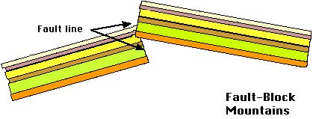
Faulting

Slide 20
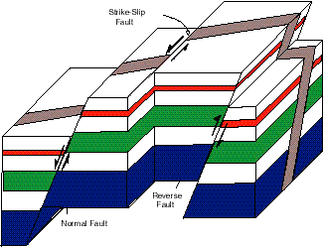

Slide 21
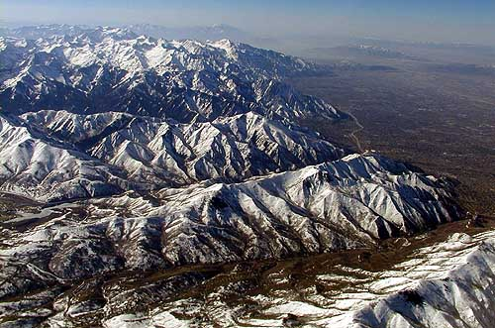
Wasatch Mountains

Slide 22
Volcanoes
Utah was covered with active volcanoes, but all of them are extinct today
They left behind craters and a few hot springs
Hot springs are formed when the water is heated by rocks beneath the surface
Volcanoes formed small mountains in the Great Basin and Colorado Plateau

Slide 23
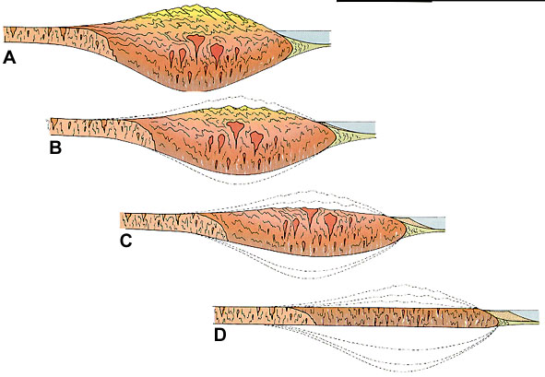
Volcanic Mountains
D
C
B
A

Slide 24
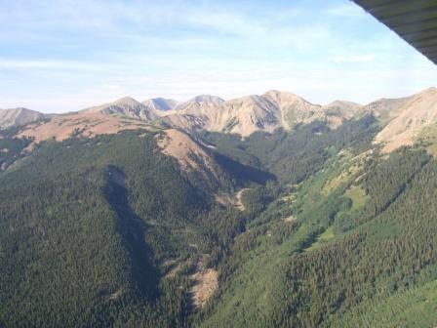
LaSal Mountains

Slide 25
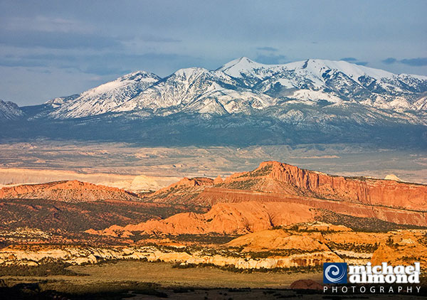
Henry Mountains

Slide 26
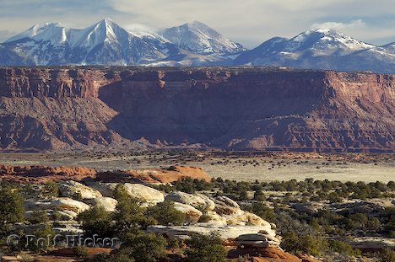
Colorado Plateau
This area was raised into a high, flat area during the buckling and folding
Water erosion (wearing away) caused the sedimentary rock to form cliffs and canyons
Some amounts of volcanic activity also formed small mountain ranges in this region

Slide 27
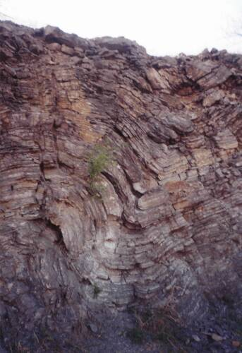
Folding

Slide 28
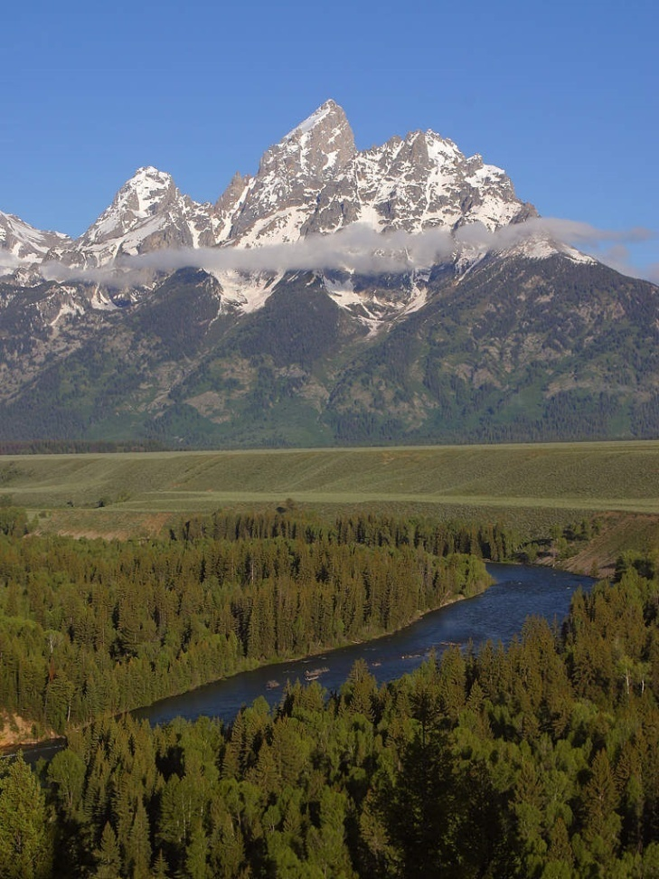
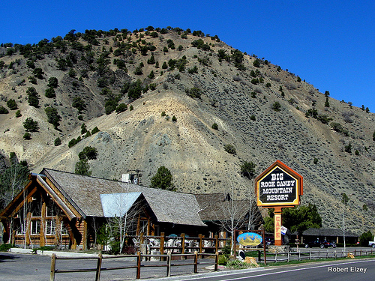
Which one was formed by Volcanoes?

Slide 29
Rocks and Minerals
Utah has many fossil fuels: oil, natural gas, and coal
Utah also has copper, gold, and silver
Utah has enough salt to satisfy the world’s needs for a thousand years
Sand and gravel were also left behind by Lake Bonneville and are used to make cement
Building stones such as quartz, sandstone, limestone, granite, and marble

Slide 30
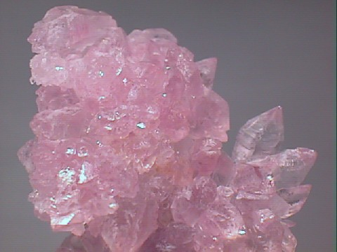
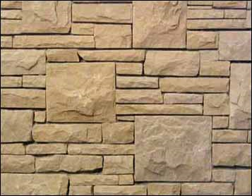
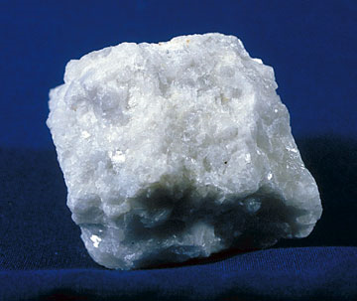
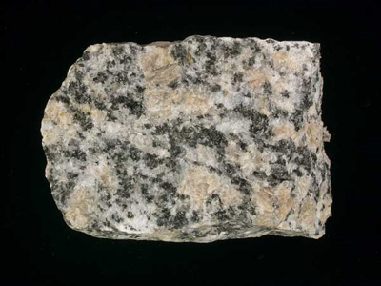
Quartz
Sand stone
Marble
Limestone
Granite

Slide 31
Ice Age
Last major shaping of Utah took place
A huge sheet of ice covered much of North America, BUT NOT UTAH! We only had small sheets of ice.
Glaciers formed over the Rocky Mountains
Some glaciers are still found at high elevations
Many glacial lakes were formed
Canyons and basins were created as the glaciers moved along the mountain
When the glaciers melted, they filled basins with water
These reservoirs provide Utah with important water sources

Slide 32
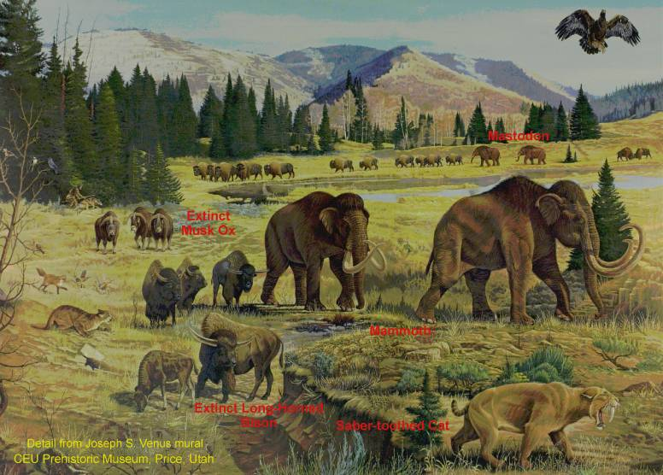
Life in Utah at the end of the Ice Age
Ice Age Animals
Deer, chipmunks, rabbits, gophers mice
Mammoths, sloths, ancient bison, musk ox, cave bears, camels, saber-toothed tigers
Notes:
Life in Utah at the end of the Ice Age
This is a scene from the Ice Age mural by Joseph S. Venus at the College of Eastern Utah Prehistoric Museum in Price, Utah. It is a reconstruction of Ice Age life found in Utah.

Slide 33
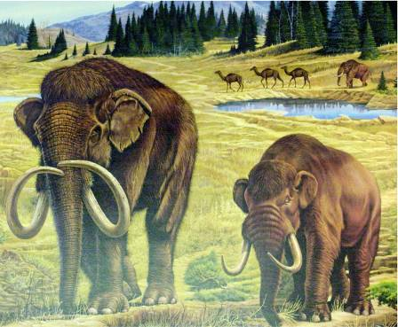
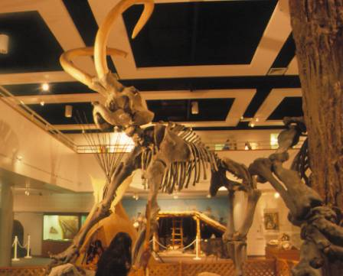
Ice Age Elephants
Mammoth Mastodon
The Huntington Mammoth
Notes:
Ice Age Elephants - Mammoths and Mastodons
Mammoths (Mammuthus) and mastodons (Mammut), members of the order Proboscidea, are extinct relatives of living elephants that were common throughout the Ice Age of North America. The mastodons evolved in Africa about 35 million years ago and spread throughout Africa, Europe, and Asia. About 3.7 million years ago mastodons migrated to North America via the Bering Land Bridge. The mammoths appeared in sub-Sahara Africa about 3-4 million years ago, migrated across Europe, Asia, and Berengia, and eventually crossed over the Bering Land Bridge into North America about 1.7 million years ago. Both the mastodon and mammoth became extinct at the end of the Ice Age, about 10,000 years ago.

Slide 34
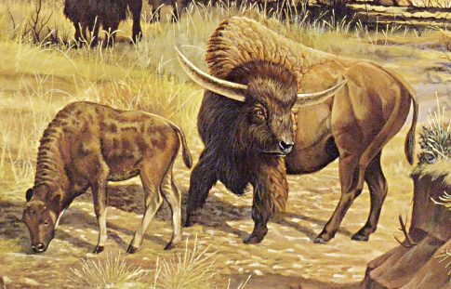
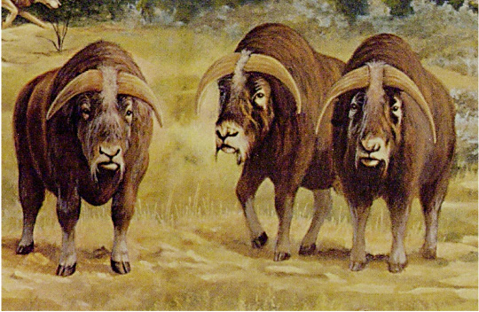
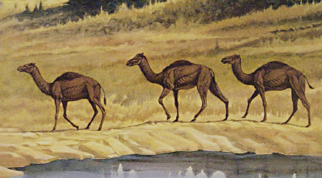
Other Extinct Ice Age Mammals
Extinct Long-Horned Bison
Extinct Musk Ox
Notes:
Other Extinct Ice Age Mammals
Camel, horse (not pictured), long-horned bison, and musk ox fossils have all been found in Utah. Horses evolved in North America and crossed into Asia via the Bering Land Bridge. They became extinct at the end of the Ice Age, only to be reintroduced by European settlers. Camels, like horses, are also New World natives that evolved here and entered Asia via the Bering Land Bridge. Unlike horses, however, some of the camel family – llamas, survived the Ice Age. Bison evolved in Eurasia and migrated to North America near the end of the Ice Age. Two extinct species of long-horned bison found in Utah are close relatives of our modern bison. The helmeted musk ox (Bootherium bombifrons) was one of five different kinds of muskoxen that lived in North America during the Pleistocene. However, it appears to have been the only one to have evolved and remained restricted to North America. It is the most common mammal fossil found along the shores of ancient Lake Bonneville. Two new sites have produced partial skulls of these muskoxen. One is from a gravel pit near the Kennecott Copper Mine west of Salt Lake City, and the other is from the construction site of the Huntsman building at the University of Utah.

Slide 35
Lake Bonneville
Ice Age temperatures heated up and melted the ice
The water formed a huge lake that spread over much of Utah
At its largest, it covered 20,000 square miles and was nearly 1,000 feet above the current Great Salt Lake

Slide 36
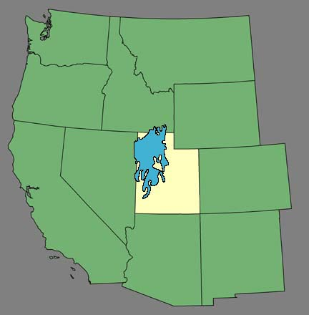
Lake Bonneville ~18,000 years ago
Lake Bonneville washed against the sides of the mountains, forming benches, or terraces, that were flat places people live on today
Warming caused the lake to shrink and each change left a new bench on the mountain side
Salt Lake
Delta
Utah
Notes:
Lake Bonneville ~18,000 years ago
Regional map of Lake Bonneville at its highstand about 18,000 years ago. Note that Lake Bonneville extended across most of northwestern Utah and into parts of Idaho and Nevada.

Slide 37
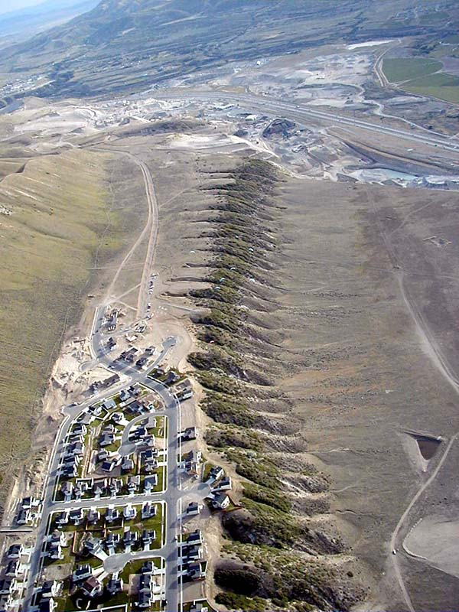
Bonneville Shoreline at Point of the Mountain
Paragliders
Notes:
Bonneville Shoreline at Point of the Mountain (view to the southwest)
This once pristine shoreline near Draper, Utah, is now the site of subdivisions and an expanding gravel pit. The site is also a popular hang gliding and paragliding launch spot. Note the paragliders flying above the ridge on the inset to the right. With increasing building and excavation in this area, pilots are running out of places to land!

Slide 38
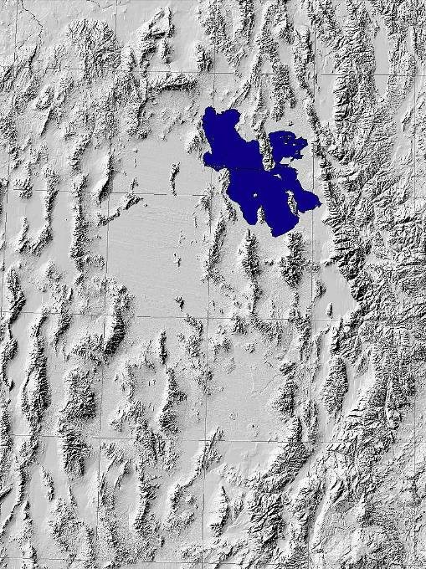
Great Salt Lake Today
Red Rock Pass
ID
NV
UT
8,000 years ago, the lake was lowered when water broke through Red Rock Pass and flowed to the ocean
Ogden
Salt Lake
Provo
Nephi
Delta
Notes:
Great Salt Lake Today
This map depicts present-day Great Salt Lake. Great Salt Lake is the largest remaining remnant of Lake Bonneville. Other relics of Lake Bonneville are Utah Lake, Sevier Lake, and the Great Salt Lake Desert containing the famous Bonneville Salt Flats. The chemical composition of Great Salt Lake is similar to that of typical ocean water. Sodium and chloride are the major ions in the water, followed by sulfate, magnesium, calcium, and potassium. Although much of the salt contained in the Great Salt Lake was originally in the water of Lake Bonneville, a small amount of dissolved salts is deposited in the lake every year by rivers and numerous small streams that feed into it. As the lake rises, its salinity drops because the same amount of salt is dissolved in more water. In historical time, the lake's salinity has ranged from a little less than 5% (just above that of sea water) to nearly 27% (beyond which water cannot hold more salt).

Slide 39
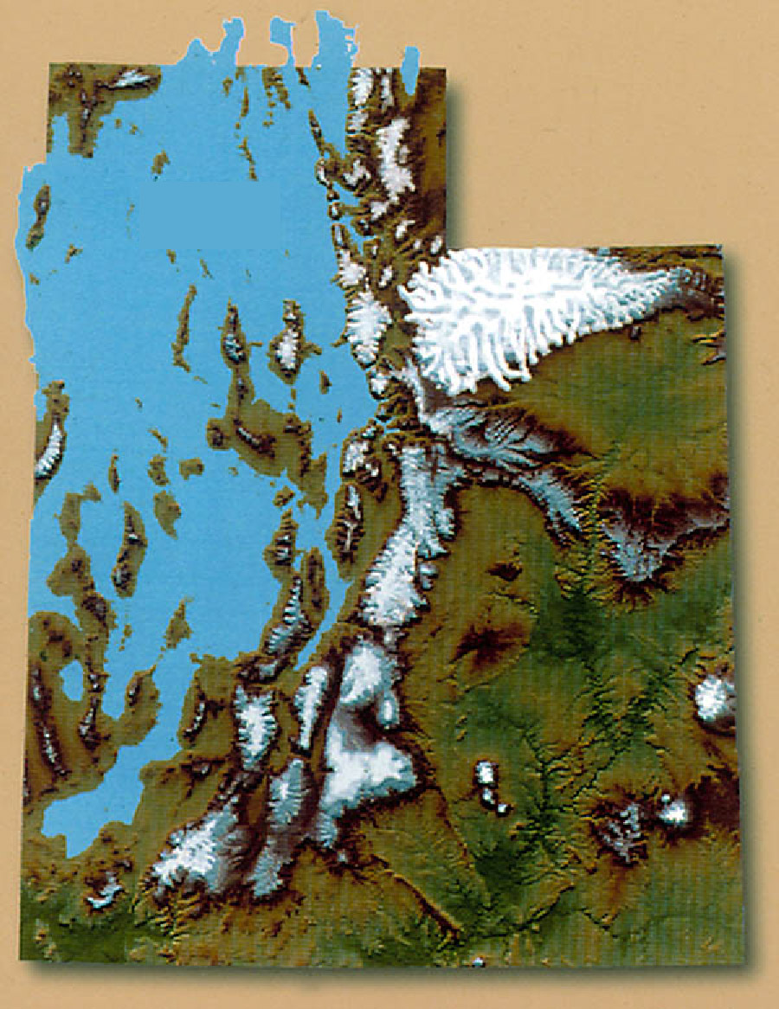
Lake Bonneville and Ice Coverage in Utah ~18,000 years ago
Mountain streams flowing into the lake deposited sediment, forming the best soil for farming in the state and large gravel deposits
Lake
Bonneville
Uinta Mountains
Wasatch
Range
Notes:
Lake Bonneville and Ice Coverage in Utah During the Late Pleistocene ~18,000 years ago
This map shows Lake Bonneville and the maximum extent of ice coverage in Utah about 18,000 years ago. Notice the broad expanse of ice that covered the Uinta Mountains! The Wasatch Range also underwent some glaciation during the most recent ice age. The power of these large glaciers hundreds of feet thick left their mark on the mountainous landscape of the Wasatch, creating most of the beautiful mountain scenery we have today. The cooler, wetter climate in the late Pleistocene caused Lake Bonneville to rise to its maximum level and large amounts of snow and ice to accumulate in mountainous regions.

Slide 40
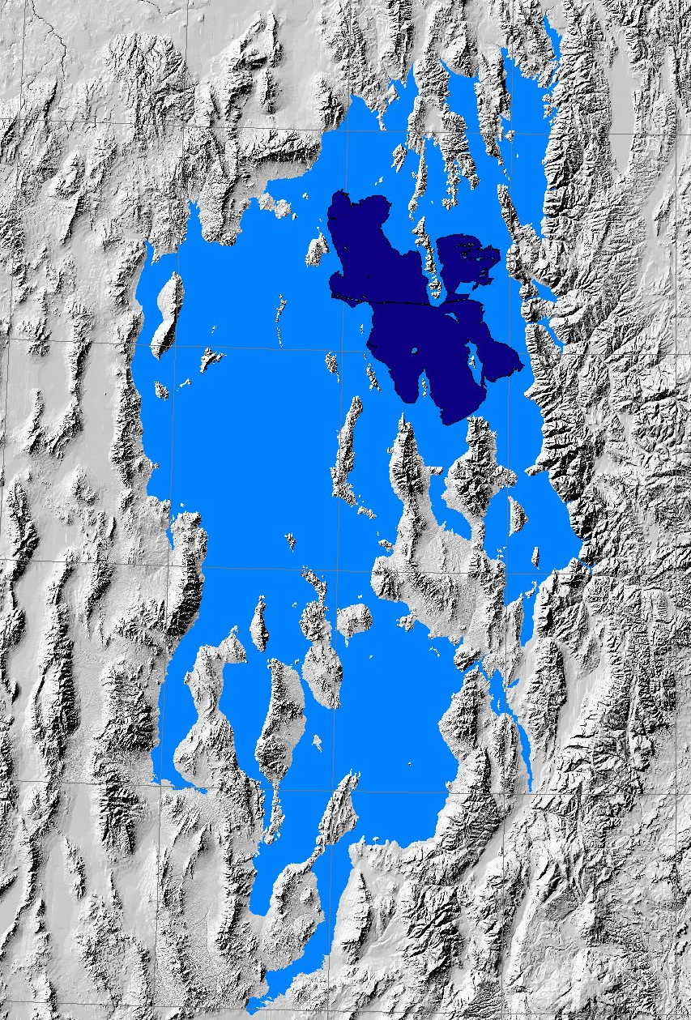
Bonneville Shoreline
Red Rock Pass
ID
NV
UT
~18,000 years ago
Ogden
The Great Salt Lake, Utah Lake, and Sevier Lake are left behind from this
Point of the Mountain
Salt Lake
Provo
Nephi
Delta
Notes:
Bonneville Shoreline ~18,000 years ago
This map depicts Lake Bonneville about 18,000 years ago. This is the highest stage of Lake Bonneville and at this time the lake level was controlled by a threshold near Red Rock Pass, Idaho. About 17,500 years ago, the threshold broke and water spilled out catastrophically into the Snake River drainage. This event is called the Bonneville flood. It is estimated that in less than one year, the amount of water that flowed out of Lake Bonneville was equivalent to all of the freshwater flowing in the world today!
One of the best places to view the Bonneville shoreline is at Point of the Mountain in Draper, Utah. The flat bench extending from Point of the Mountain to the east was formed by waves and currents in Lake Bonneville.

Slide 41
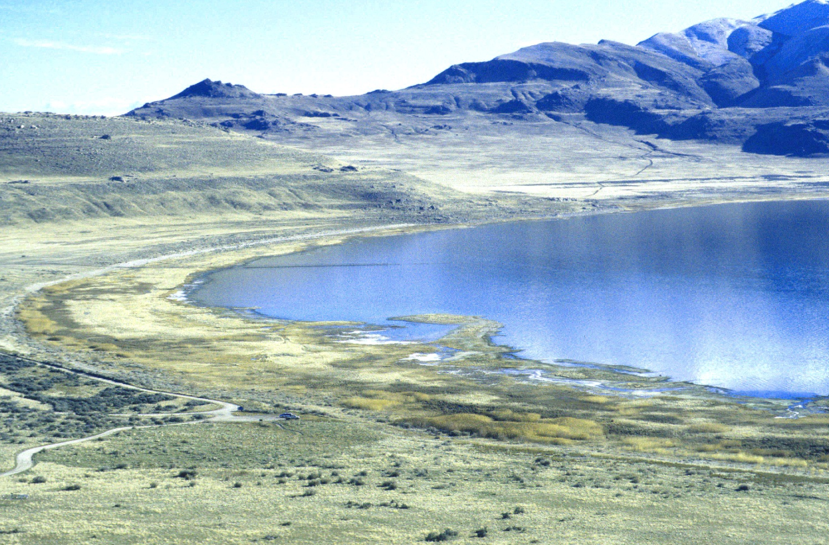
Shorelines of Lake Bonneville at Antelope Island
Bonneville
Provo
Unnamed shoreline
Stansbury
Gilbert
Unnamed shoreline
Notes:
Shorelines of Lake Bonneville on Antelope Island
Well-defined shorelines are visible at Buffalo Point on the northwest side of Antelope Island. Notice that there are more than four shorelines present. Dozens of unnamed shorelines associated with the oscillations of Lake Bonneville can be seen around the Bonneville basin.

Slide 42
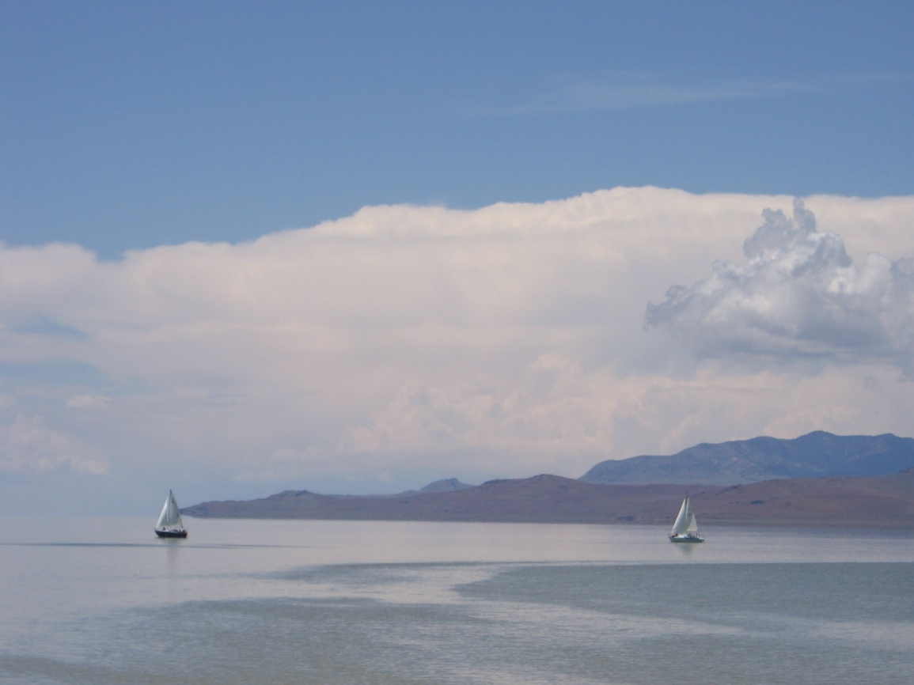
The Great Salt Lake Today
The Great Salt Lake is Utah’s largest body of water
It is found in a basin
It is very shallow
Rivers flow into the lake, with minerals, but no rivers flow out —making it very salty
It is saltier than the ocean, and too salty for fish

Slide 43
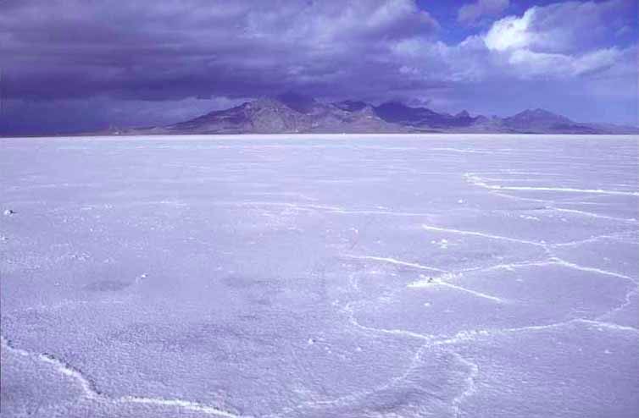
Bonneville Salt Flats

Slide 44
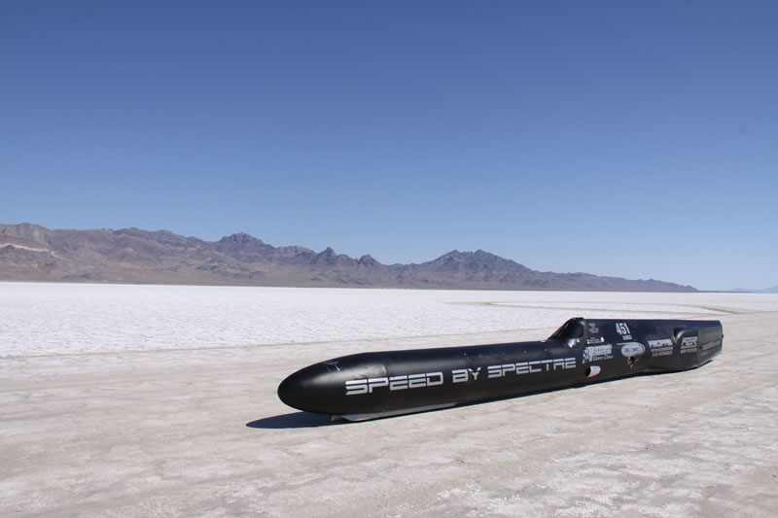

Slide 45
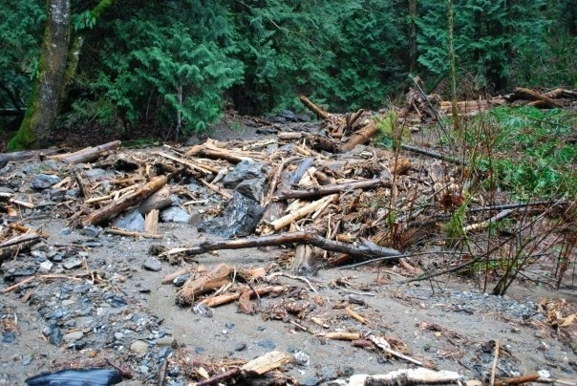
Natural Forces Shaping Utah Today
Wind, water, ice, heat, and cold shape the land today through erosion
Mud slides, rock slides, floods, and earthquakes change things

Slide 46
Earthquakes in Utah today…
Over 700 earthquakes occur in Utah each year.
Most of Utah’s Major cities are built on a giant fault line called the Wasatch front

Slide 47
What is liquification?
Liquification is when supersaturated sandy soil acts like a liquid in an intense earthquake.
Where will it happen in Utah?
In the Salt Lake Valley… Sandy, South Jordan, salt lake etc
What will happen to that place when it occurs?
Large objects will sink

Slide 48
What could happen to Alpine in an earthquake?
Mud slides and rockslides
When is the only time you should use the phone after an earthquake?
Incase of a severe injury (life and death)
Why is this the only time you should make a phone call after an earthquake?
Phone lines will be overloaded and important calls will not get through in time.

