Slide 1
Passing through the great basin
Pioneers Before the Mormons

Slide 2
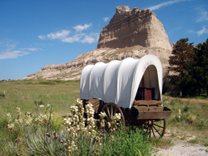
Manifest Destiny
John O’ Sullivan wrote, “It is the manifest destiny of the United States to spread across the continent.”
Means that the United States reach from the Atlantic to the Pacific, including Canada & Mexico.

Slide 3
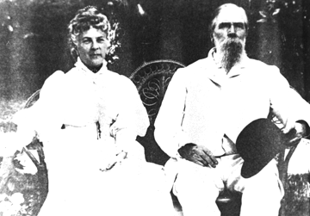
Bidwell-Bartleson Party was the first wagon train party to cross Northern Utah in 1841.
“Our ignorance of the route was complete. We knew that California lay west, and that was the extent of our knowledge.”
John Bidwell

Slide 4
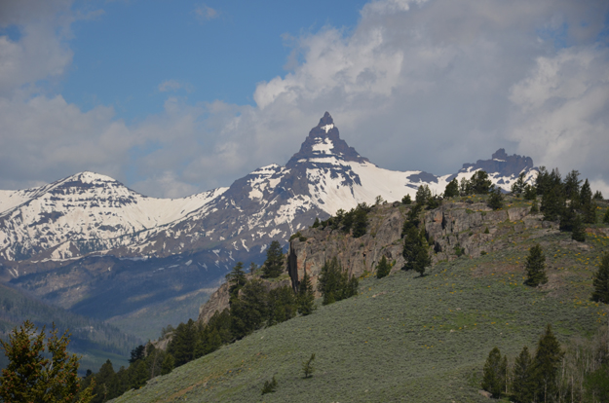
Hastings Cutoff
Lansford W. Hastings suggested a more direct route to California by the Great Salt Lake. John C. Fremont agreed it could be done.
Pilot Peak

Slide 5
Donner Party
Last group of the year to use Hastings Cutoff
Hacked a road through Emigration Canyon taking up weeks
Got trapped in the Sierra Nevada Mountains through Winter and had to eat dead party members to survive.

Slide 6
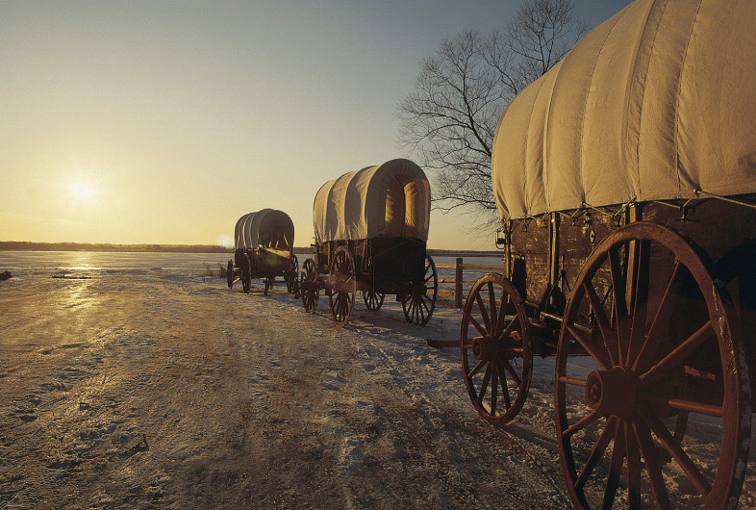
Mormon Pioneers
Chapter 5
Their Faces Toward Hope:
The Long Journey to Utah

Slide 7
Who are the Mormons?
Mormon -the term most often refers to a member of The Church of Jesus Christ of Latter-day Saints (LDS Church), which is commonly called the Mormon Church.
The Mormon church was founded by a man named Joseph Smith.

Slide 8
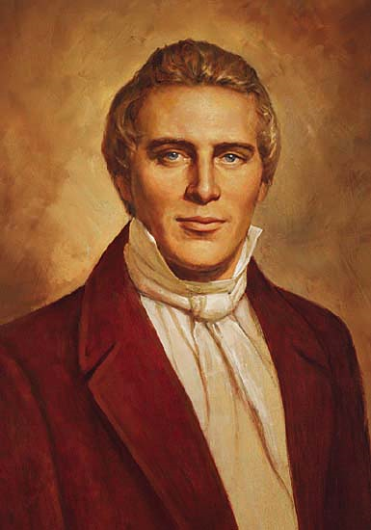
Joseph Smith
Claimed he saw a vision telling him not to join any of the churches (Palmyra, NY).
He claims he was visited by heavenly messengers for a number of years.
He said he was led to a hillside, found gold plates, translated them, and Mormons are those that believe this is the Book of Mormon.

Slide 9
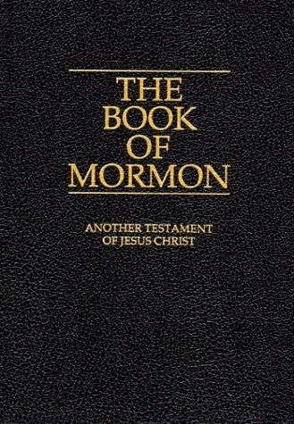
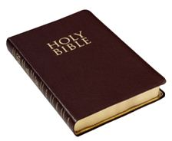
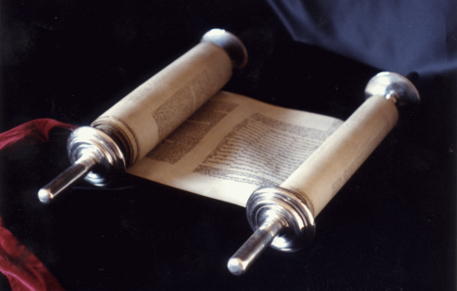
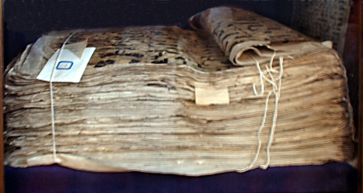
Where does the name Mormon come from?
The term "Mormon" has its origins in the Book of Mormon, which is believed by Latter Day Saints to be a religious and historical record translated from golden plates by Joseph Smith, Jr. into English by divine inspiration.
Mormons believe that the Book of Mormon is another scriptural witness of Jesus Christ that is comparable to the Bible, which they also believe to be the word of God
Bible=Christian
Torah=Jewish
Koran= Islam

Slide 10
Names to remember
Church of Jesus Christ of Latter-day Saints
LDS
Mormon

Slide 11
Where do the Mormons start and end up ?
New York
Ohio
Missouri
Illinois
Iowa
Nebraska
Wyoming
Utah

Slide 12
Why did they keep moving?

Slide 13
6 Reasons for Mormon persecution

Slide 14
Reasons for Mormon Persecution
#1
Mormon’s claim to be the only true church

Slide 15
Reasons for Mormon Persecution
#2
Some of Church Leaders in Illinois started living in Polygamy

Slide 16
Reasons for Mormon Persecution
#3
They outnumbered their neighbors

Slide 17
Reasons for Mormon Persecution
#4
Mormons voted together and neighbors feared Mormons would take over politically.

Slide 18
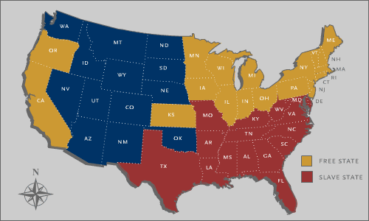
Reasons for Mormon Persecution
#5
Mormons were against slavery- Missourians wanted to be a slave state.

Slide 19
Reasons for Mormon Persecution
#6
Mormons lived a communal lifestyle -they all gave what they had to the church. This gave leaders a lot of power.

